Slide 2
Task Set 2:
Building Arguments and Expressing Comparison-Contrast (Part 3 of 3)
Grade 11 Reading and Writing
December 5 to 6, 2018 ~
Writing Guidelines and Steps

Slide 3
A few reminders…
Please be reminded of the following:
This third installment of the learning guide is for the complete flow of the entire academic discourse.
A section on academic language and other important conventions on grammatical and vocabulary elements is provided.
As always, follow both general and specific guidelines in accomplishing the complete output.

Slide 4
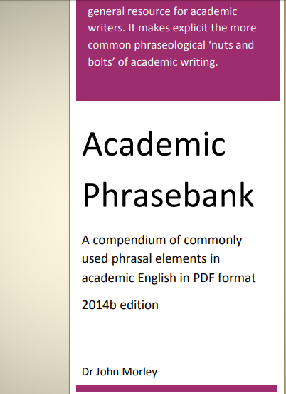
A few reminders…
An academic language guide has been provided for your further learning of proper and effective academic writing:
Some sample phrases from this resource are provided for each section of your writing output.
See particular sections of PDF file for more examples.

Slide 5
Review of overall structure….
Each Topic Sentence should be aligned and relevant to the specific support claims in the thesis statement.
The content of the Summary must be based on the discussion points / topic sentences in the discussion paragraphs.
The Background presents the most fundamental / most important basic facts and concrete information about the topic.
CONCLUSION
DISCUSSION
Summary of Discussion
Restatement of the Thesis
Recommendation / Call to Response
INTRODUCTION
Topic Sentence(s)
Elaboration
Evidence
Closing
Hook
Background
Thesis ➔
Each discussion paragraph needs a clear elaboration of its topic sentence. Evidence such as facts, expert views or numeric data must be presented. A concise wrap-up sentence should close each paragraph.
The Restatement of the Thesis is a one-to-two sentence reiteration of the Thesis Statement. It elaborates the main claim concretely, but without using the same words.
The Thesis Statement must provide a valid, clear, and concise main claim that is supported by specific claims.

Slide 6
Review of overall structure….
The HOOK used to engage readers must be relevant and appropriate to the topic and the Thesis.
INTRODUCTION
Effective BACKGROUND INFORMATION presents a concrete scenario or set of fundamental facts / specific information about the topic.
Hook
Background
Thesis
An effective THESIS STATEMENT is one that clearly proposes a main claim about the subject that is supported by specific points or bases.

Slide 7
Review of overall structure….
For Assessment 2: There must be 1 to 2 Counterclaim paragraphs.—A contradiction or negation to the Thesis Statement. (Antithesis).
DISCUSSION
(for counterclaim)
Similar to other topic sentences in other discussion paragraphs, the counterclaim statement must be elaborated in objective terms (without use of abstract words that cannot be explained concretely).
Counterclaim
Elaboration
Evidence
Closing
Explanations of the counterclaim must be backed up by Evidence (specific information, data, numeric figures or published claims for reliable sources).
Each discussion paragraph needs a clear, relevant, concise but brief Closing statement that provides transition to the next paragraph.

Slide 8
Review of overall structure….
An effective discussion paragraph starts with a Topic Sentence that elaborates each specific claim in the Thesis Statement.
DISCUSSION
Each Topic Sentence must be elaborated in objective terms (without use of abstract words that cannot be explained concretely).
Topic Sentence(s)
Elaboration
Evidence
Closing
Explanations of the support claims must be backed up by Evidence (specific information, data, numeric figures or published claims for reliable sources).
Each discussion paragraph needs a clear, relevant, concise but brief Closing statement that provides transition to the next paragraph.

Slide 9
Review of overall structure….
The Summary must contain brief but clear and comprehensive statements that put together the discussion points (expressed by the topic sentences in the discussion paragraphs)..
CONCLUSION
Summary
Restatement of the Thesis
Recommendation / Call to Response
The Thesis Statement must be restated / reiterated (explained/elaborated more concretely, but without use of the same words).
An effective Recommendation / Call to response states a concrete action or line of thought that is relevant to and or aligned to the Thesis and discussion points.

Slide 10
On Academic Language
(Developing an appropriate language style and use in academic writing)

Slide 11
Preparing to write academically…
General guidelines for proper academic writing
Use information from your research to develop relevant and objective insights regarding your claim about the topic.
Statements expressing insights must avoid using abstract words or terms (e.g. “patience,” “care,” etc.)
Remember that the facts or data from your research are your tools in expressing insights objectively.

Slide 13
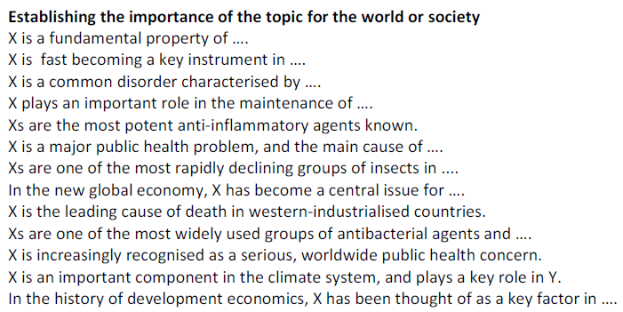
A. Writing the Introduction…
NOTE: Words such as “common disorder,” “anti-inflammatory agents” and other similar content words are ONLY EXAMPLES.
Replace them with content words based on your topic.

Slide 14
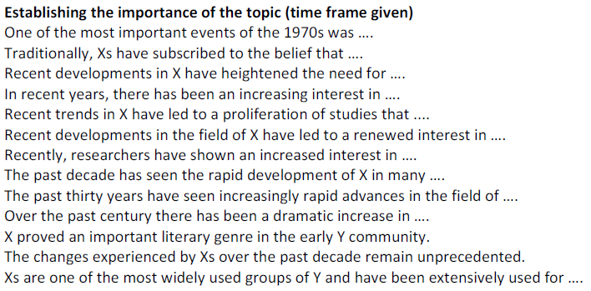
A. Writing the Introduction…
NOTE: “time frame” refers to the particular period of time during which the topic is relevant and or of interest to the audience.
This also implies that the topic itself must be timely and up-to-date.

Slide 15
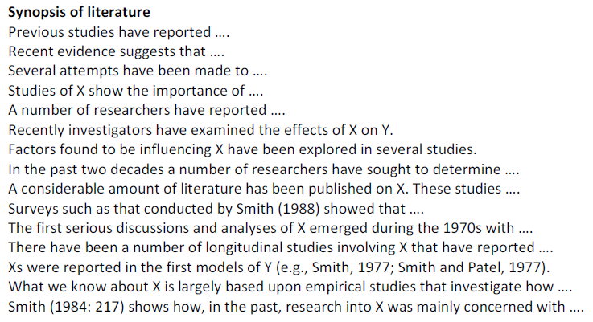
A. Writing the Introduction…
NOTE: Related literature is important for use in providing a substantial and factual background of the topic. This indicates that the background must use concrete facts or information.

Slide 16
A. Writing the Introduction…
NOTE: Related literature is important for use in providing a substantial and factual background of the topic. This indicates that the background must use concrete facts or information.

Slide 17
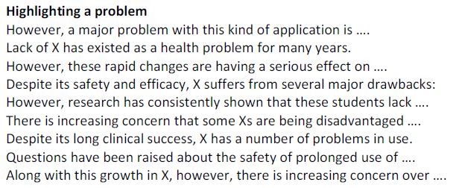
A. Writing the Introduction…
NOTE: These phrases are most useful in expressing problems the topic encompasses or involves. The “X” represents a specific idea that must be filled in or provided as you write.

Slide 18
A. Writing the Introduction…
For more structures helpful in developing the introduction more effectively, see the following pages of the PDF file provided for academic language use:
- Pages 46 to 47

Slide 20
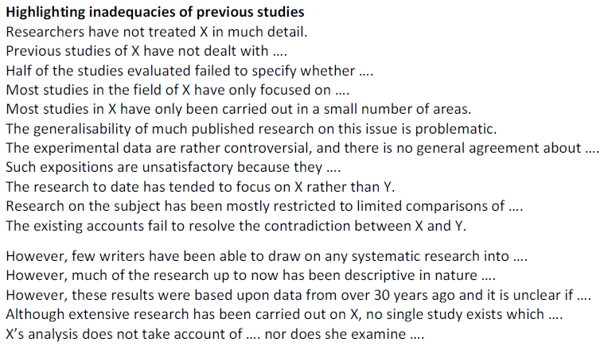
B. Writing the Discussion…
NOTE: The phrases included are most useful in expressing COUNTERCLAIMS in the discussion. Use phrases that help in stating a contradiction to the Thesis (Antithesis).

Slide 21
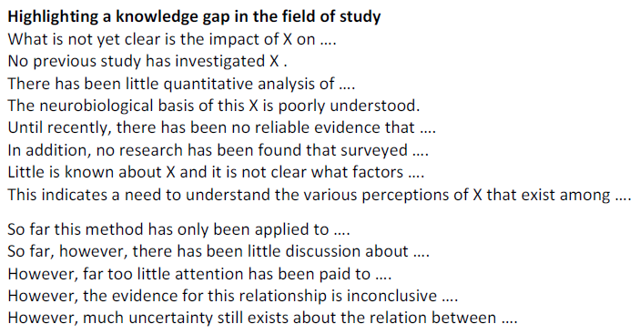
B. Writing the Discussion…
NOTE: “Knowledge gap” refers to a lack of information or specific data on a particular issue or aspect of the topic. These phrases are also helpful in expressing the counterclaim (Antithesis).

Slide 22
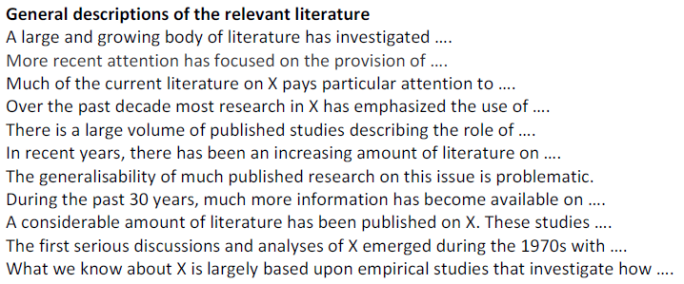
B. Writing the Discussion…
NOTE: The phrases here can be used either in the BACKGROUND (INTRODUCTION) or in discussion EVIDENCE. Use of these phrases help in expressing what has been published about specific ideas or claims.

Slide 23
B. Writing the Discussion…
For a comprehensive list of relevant structures helpful in developing the discussion, see the following pages of the PDF file provided for academic language use:
Pages 48 to 49 (Describing trends/qualities)
Pages 50 to 51 (Explaining causality)
Pages 52 to 53 (Giving examples as support)
Pages 54 to 55 (Signalling transition)

Slide 25
B. Writing the Conclusion…
As done in the previous assessment, the CONCLUSION is simply achieved by ensuring that the following parts are provided.
SUMMARY (based on discussion points)
RESTATEMENT OF THESIS (reiterated thesis)
RECOMMENDATION (based on thesis/discussion)
NOTE: See pages 31 to 34 of the provided PDF for useful language structures in concluding.

