Slide 1
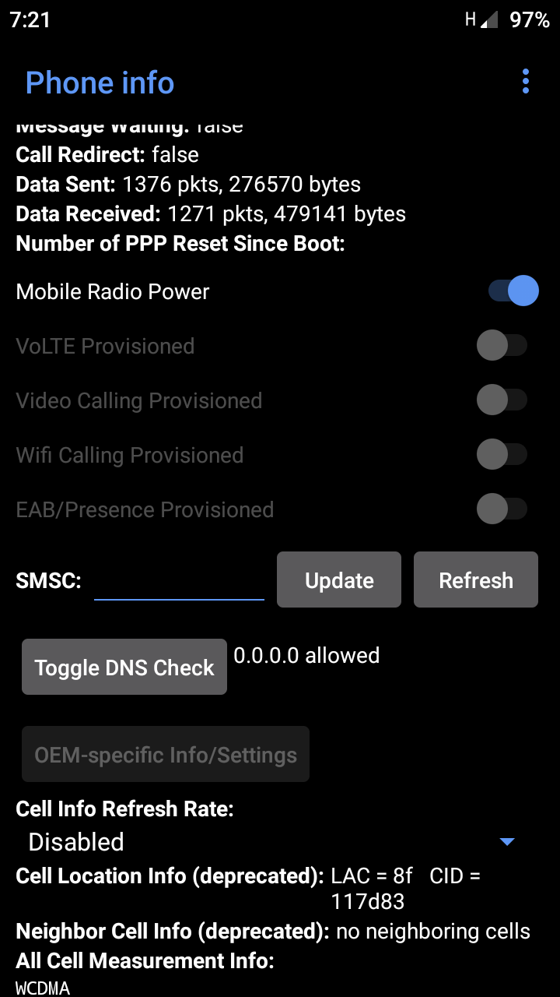
Solution 1
Under Phone Information
Scroll down
Click Refresh
Caution ! Do not click update tab if smsc
is blank or else your simcard message center # will be totally corrupt..
If update error, refresh error appeared or 00,
Means your simcard message center # is missing.
Your Simcard Protocol Description Unit( PDU) is Corrupted
In a newly android phone , customize firmware or smartphone message center # setting might be unaccesible
TODO!
1.Get non-android phone or old mobile phone pull out your simcard from your android phone and insert it
to your non-android phone
2. Go to message setting search for service center and type your message center number manually.
3. Return your simcard to your android phone and try to send your message again
That’s it your done.
Info: If you don’t know your message center # you may contact your network provider and ask for it or
You may search it on the internet and check depending on what network you belong to..

