Slide 1
STATEMENT
PROJECT MANAGEMENT PRACTICES & TOOLS
PRESENTED BY:
GROUP4

Slide 2
INTRODUCTION
PROJECT MANAGEMENT SOFTWARE
Project management software plays a crucial role in ensuring the effective planning, execution, and monitoring of projects. These tools help project managers and teams coordinate tasks, track progress, and manage resources.

Slide 3








SOFTWARE
SOFTWARE

Slide 4
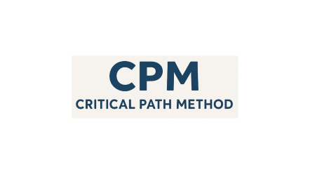
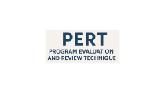
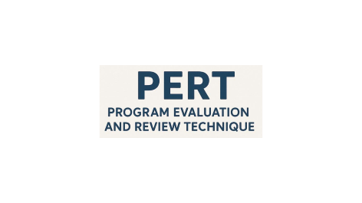
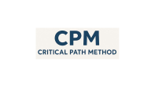
TECHNIQUES
TECHNIQUES

Slide 5

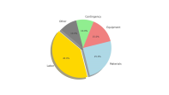
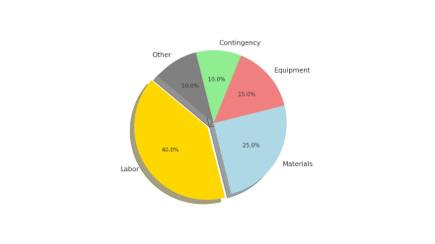

OPTIMIZATION
OPTIMIZATION

Slide 6
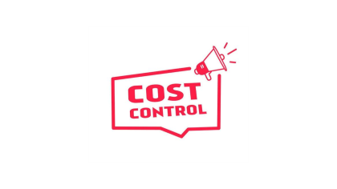

CONTROL
CONTROL

Slide 7


CONCLUSIONS
CONCLUSION

Slide 8
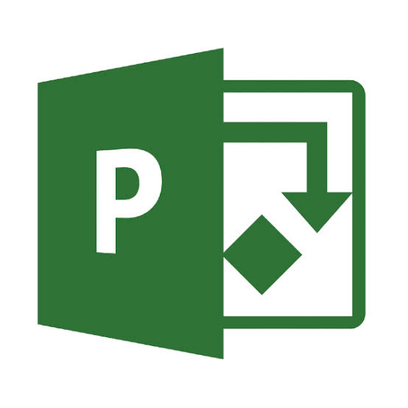

Slide 9
MICROSOFT PROJECT
A widely used tool with features like task management, Gantt charts, resource management, and reporting. Ideal for large, complex projects requiring detailed tracking of timelines and resources.

Slide 10


Slide 11
TRELLO
A visually intuitive, flexible tool using a board and card system to track tasks. It’s ideal for smaller teams and projects requiring high flexibility.

Slide 12


Slide 13
Asana
Known for its intuitive interface, Asana supports task tracking, project planning, and team collaboration. It integrates with Slack and Google Drive, making workflows more efficient.

Slide 14


Slide 15
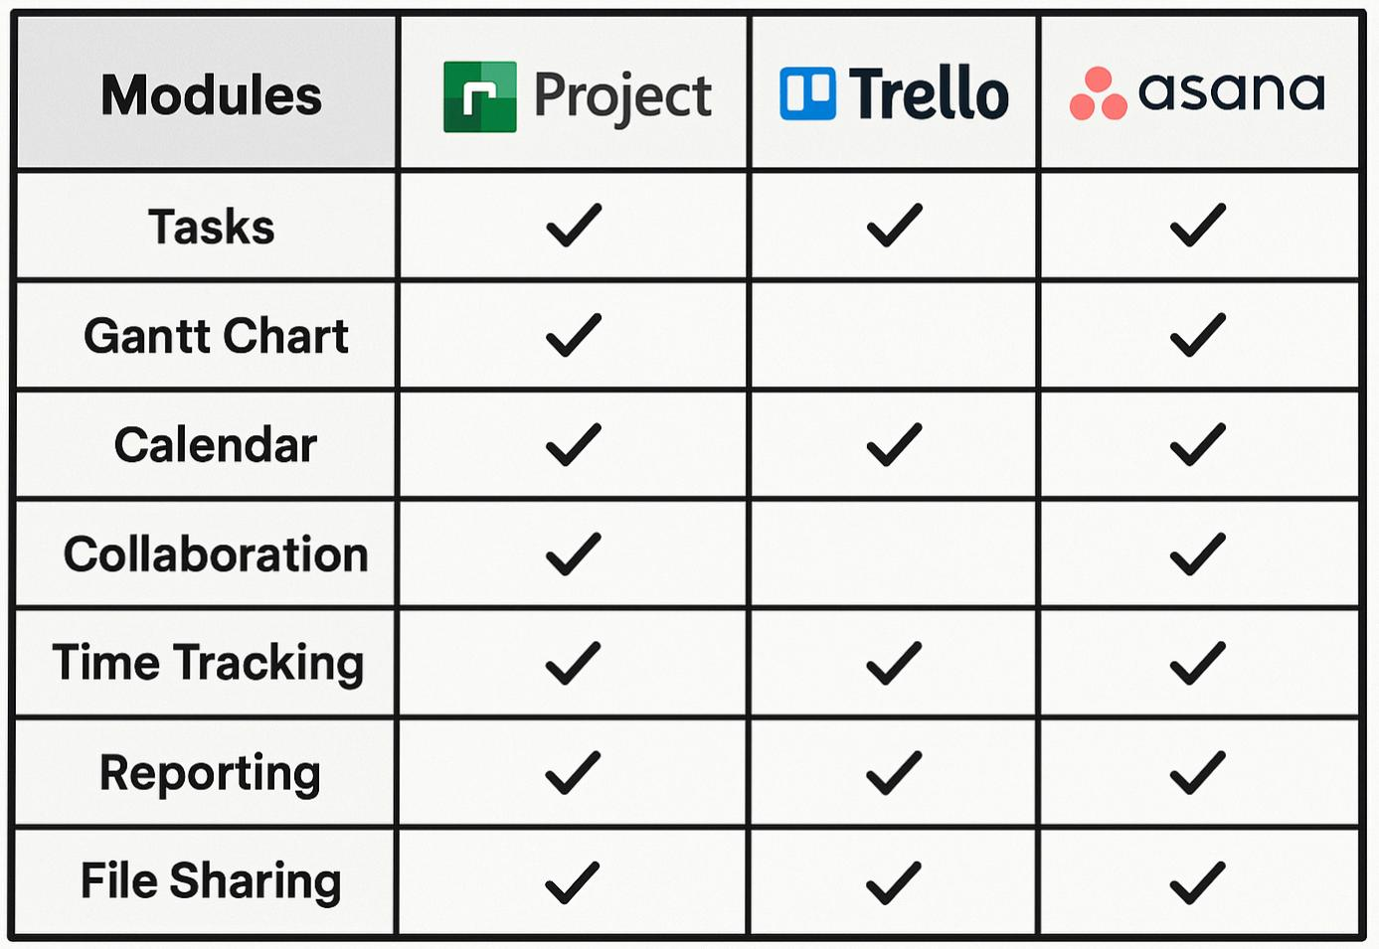
Comparison Table

Slide 16
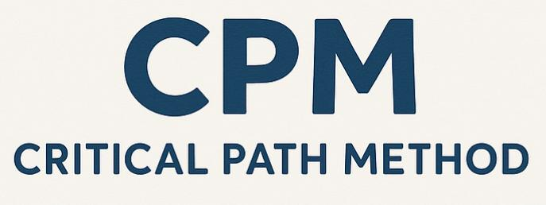

Slide 17
Critical Path Method
The Critical Path Method (CPM) is a project management technique that helps determine the longest sequence of tasks that must be completed for a project to finish on time. The critical path dictates the minimum project duration, ensuring that delays in critical tasks do not extend the project timeline.

Slide 18
Steps in CPM
1. Identify Tasks – List all project activities.
2. Determine Dependencies – Define task relationships.
3. Estimate Durations – Assign time estimates to each task.
4. Create a Network Diagram – Visualize task sequences.
5. Find the Critical Path – Identify the longest path of dependent tasks.

Slide 19
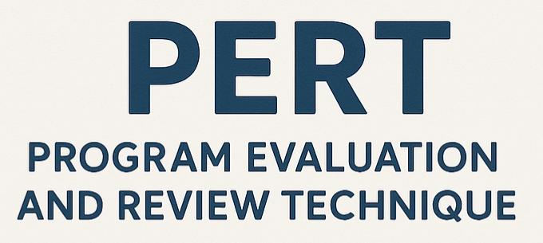

Slide 20
Program Evaluation Review Techniques
PERT is a probabilistic approach that incorporates uncertainty in task durations, making it particularly useful for projects with variable timelines. By incorporating variability, PERT provides a more flexible approach than CPM.

Slide 21

Time Estimate In PERT:
Optimistic Time (O) – Best-case scenario (fastest completion).
Pessimistic Time (P) – Worst-case scenario (longest duration).
Most Likely Time (M) – Expected scenario (realistic estimate).
Using these estimates, PERT calculates the expected task duration using the formula:
Where TE is the expected time.

Slide 22
 | CPM | PERT
PURPOSE | Used for projects with well-defined activities and predictable durations. | Used for projects with uncertain activity durations and multiple time estimates.
FOCUS | Focuses on time-cost trade-offs and critical path identification. | Focuses on probabilistic time estimation and project scheduling under uncertainty.
TIME ESTIMATION | Uses a single time estimate for each task. | Uses three time estimates—Optimistic, Pessimistic, and Most Likely.
TYPE OF PROJECT | Best for construction, manufacturing, and routine projects. | Best for research, development, and new product launches.
ACTIVITY NATURE | Deterministic (activity durations are known and fixed). | Probabilistic (activity durations vary).
CRITICAL PATH IDENTIFICATION | Determines the longest path in the project to find minimum completion time. | Uses statistical analysis to estimate the probability of project completion on time.
COST CONSIDERATION | Emphasizes cost optimization along with scheduling. | Primarily focuses on time rather than cost.

Slide 23


Slide 24
Resource Allocation
Resource allocation involves distributing available resources, such as personnel, equipment, and materials, to project tasks efficiently. Proper resource allocation ensures timely and cost-effective project completion.

Slide 25
Resource Leveling
Resource leveling is a technique used to balance workload by adjusting task schedules to prevent overallocation of resources. It smooths out resource demand to avoid bottlenecks and improve efficiency.
Benefits of Resource Leveling:
Reduces overwork and burnout.
Optimizes resource utilization and costs.
Enhances project timeline predictability.

Slide 26
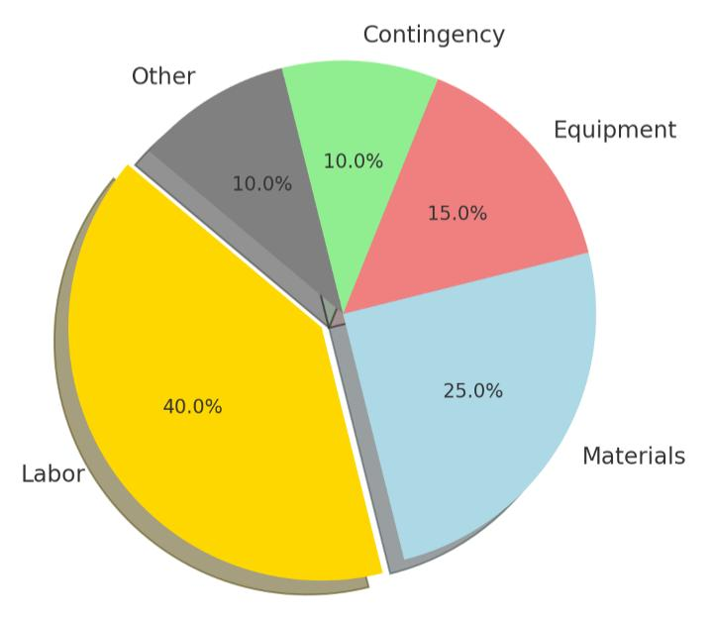

Slide 27
BUDGETING
Budgeting is the process of estimating and allocating funds for a project. A well-structured budget prevents financial overruns and ensures adequate resource availability.

Slide 28
Steps in Budgeting:
1. Estimate costs for each project phase.
2. Aggregate costs to determine the total project budget.
3. Set contingency reserves for unexpected expenses.
4. Monitor budget compliance throughout execution.

Slide 29
Budget Distribution Pie Chart

Slide 30
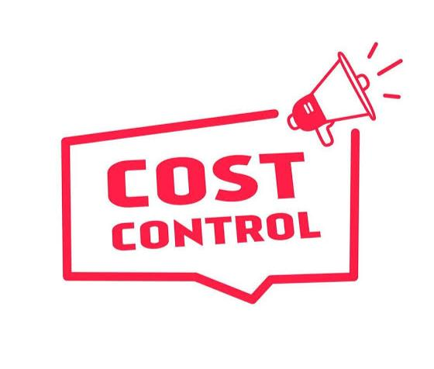

Slide 31
COST CONTROL
Cost control involves tracking expenses and ensuring that project costs remain within budget.

Slide 32
Techniques include:
Earned Value Management (EVM): Measures project performance by integrating scope, schedule, and cost.
Variance Analysis: Identifies cost deviations from the budget.
Forecasting: Predicts future costs based on ongoing performance trends.
By implementing strong budgeting and cost control practices, project managers can avoid cost overruns and improve financial efficiency.

Slide 34
CONCLUSION
Project management relies on both tools and methodologies to ensure project success. Software like MS Project, Trello, and Asana supports task management, while methodologies like CPM and PERT improve scheduling efficiency. Effective resource allocation, budgeting, and optimization models further enhance project execution. By leveraging these strategies, project managers can ensure projects are completed on time, within budget, and with optimal resource use.

Slide 35
THANK YOU

