Slide 1
For advanced learners
Tutorial
How to find a working
(payloads s/proxy's)

Slide 2
Injector setup
https://httpstatus.io.
http://www.httptunnel.ge/ProxyChecker.aspx
http://www.httptunnel.ge/proxylistforfree.aspx

Slide 3
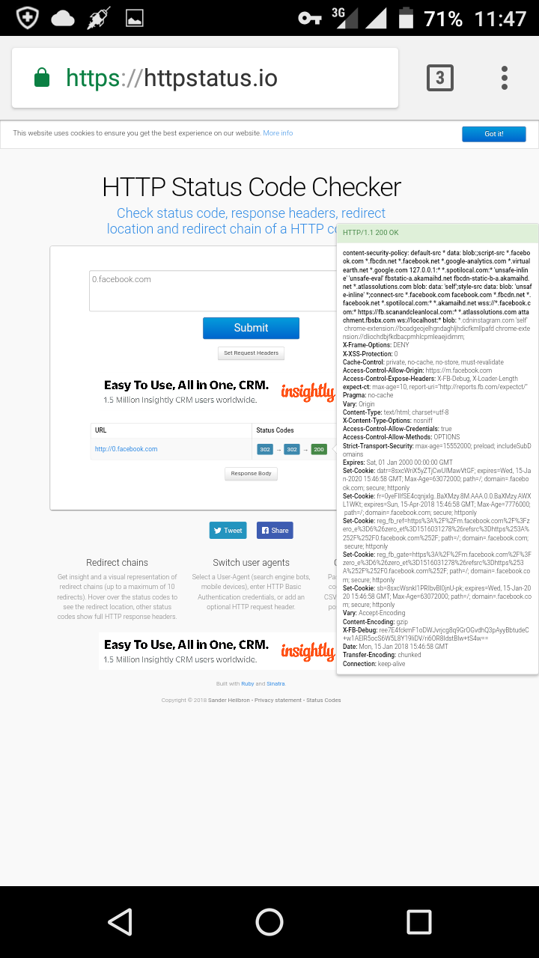
https://httpstatus.io.

Slide 4
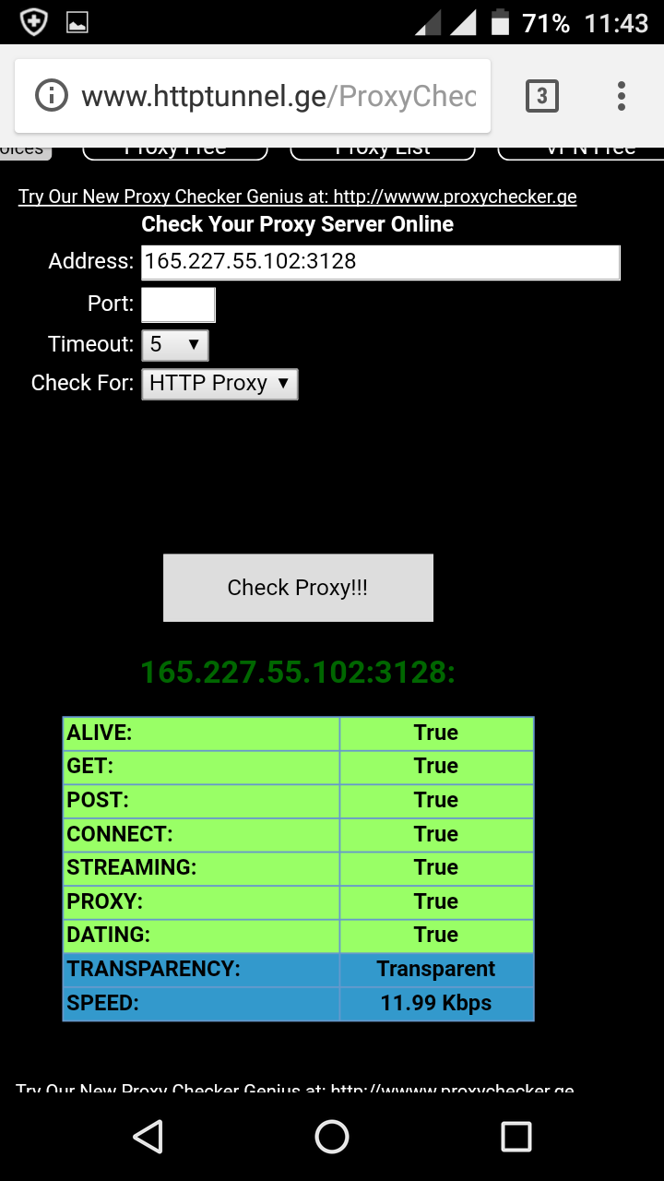
http://www.httptunnel.ge/ProxyChecker.aspx
http://www.httptunnel.ge/proxylistforfree.aspx

Slide 5
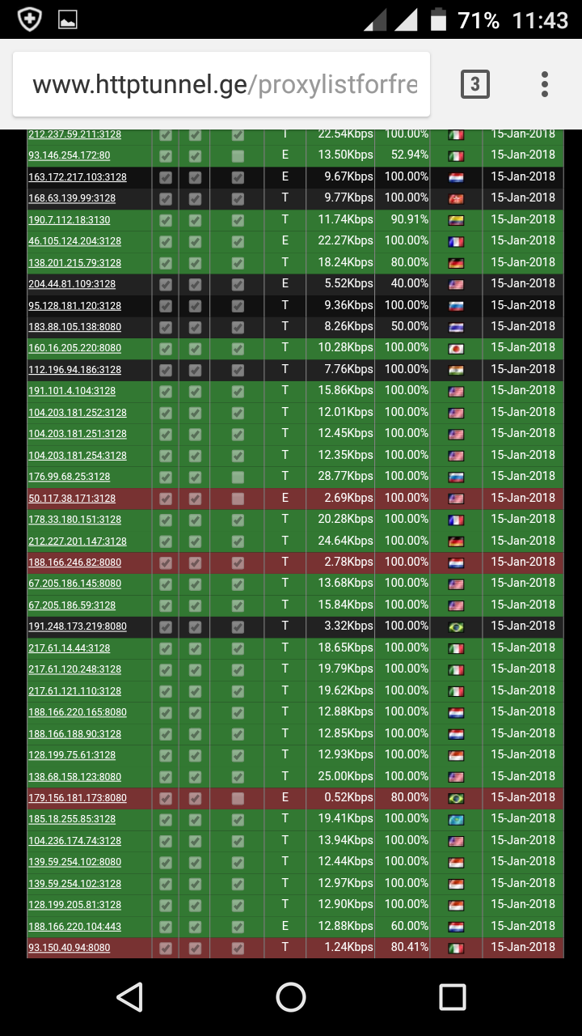
http://www.httptunnel.ge/proxylistforfree.aspx

Slide 6
Alive proxy/payload
👉 0.facebook.com
Proxy-ip. Port
👉 67.205.186.59:3128 👉usa proxy👈
Note: pag usa ang proxy dapat usa dn ang ssh account mo😱😘😘
God bless you all..

Slide 7
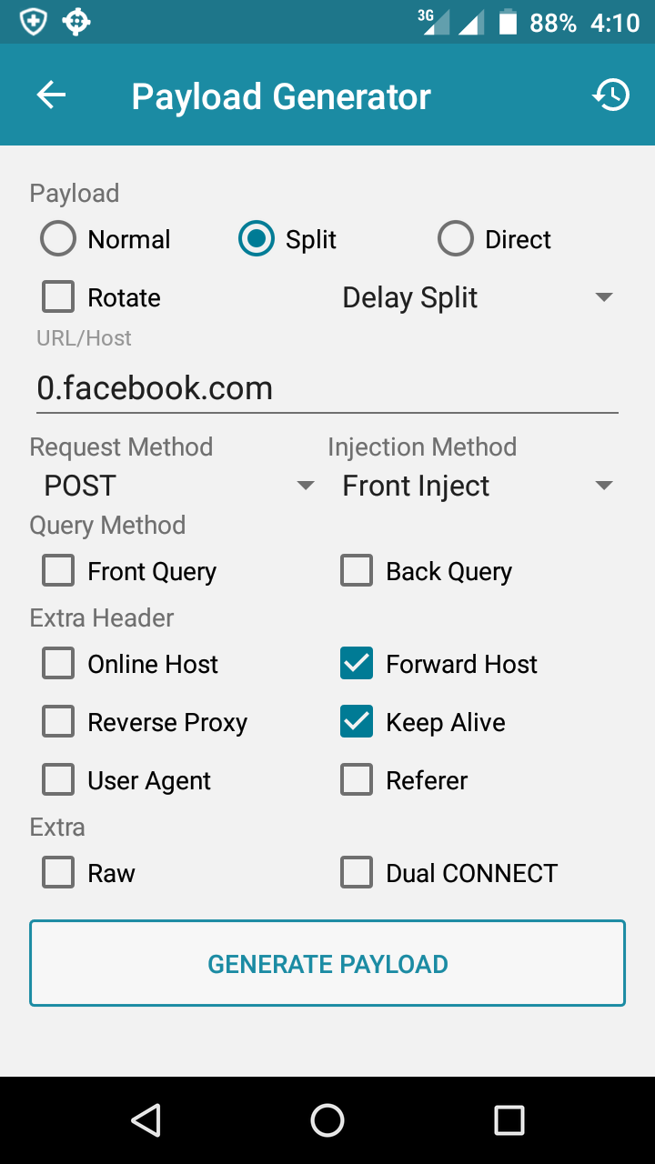
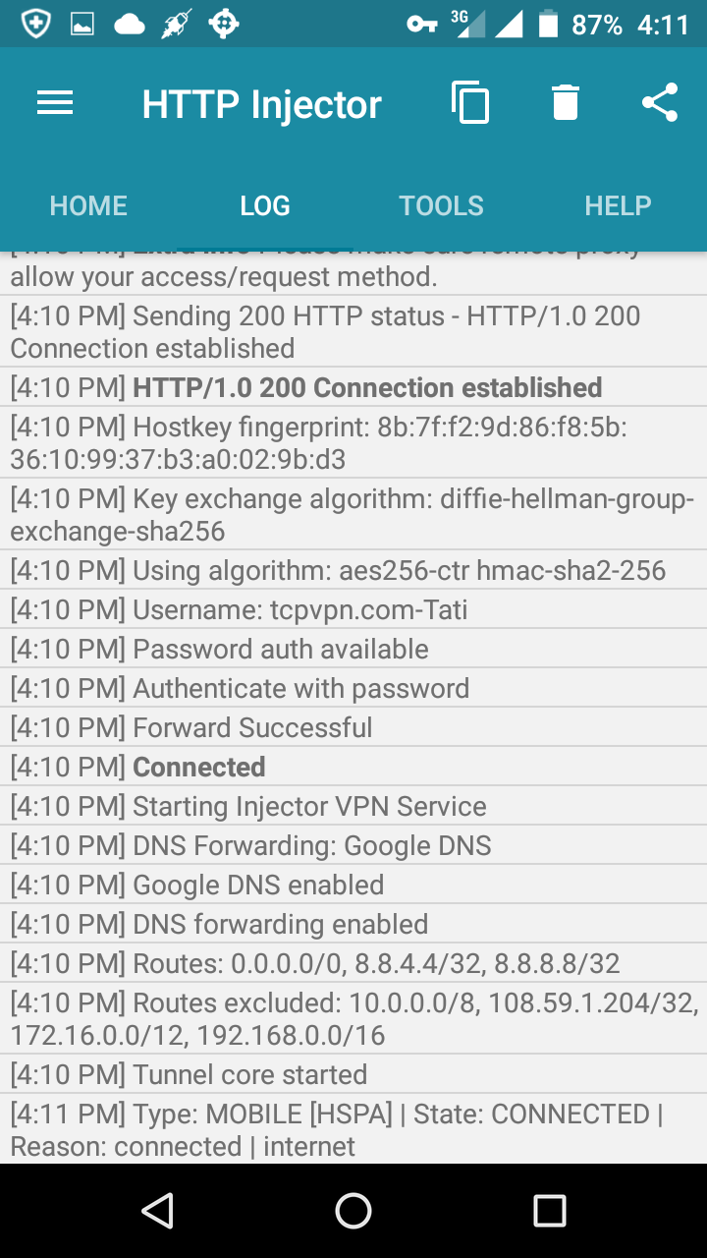
Screen shot for proof

Slide 8
For more updates.. view my thread 👇👇👇
.👇👇👇👇copy/paste 👇👇👇👇
https://www.phcorner.net/threads/478239/

