Slide 1
Basic tutorial
How to create ehi file for http injector

Slide 2
Alive proxy/payload
👉 0.facebook.com
Proxy-ip. Port
👉 67.205.186.59:3128 👉usa proxy👈
Dito kayu gumawa ng ssh account👇
👉 Tcpvpn.com 👈
Tips😉 kung usa ang proxy dapat usa din ang ssh account. 👍

Slide 3
Eto po yung ssh account Na ginawa ko kanina😉 👇👇👇
Account has been successfully created !
Username : tcpvpn.com-Tati Copy
Password : Passwordis12345 Copy
IP : 162.243.207.236
Host : us.tcpvpn.com
Date Created : 15-January-2018
Account will expire on 20-January-2018.

Slide 4
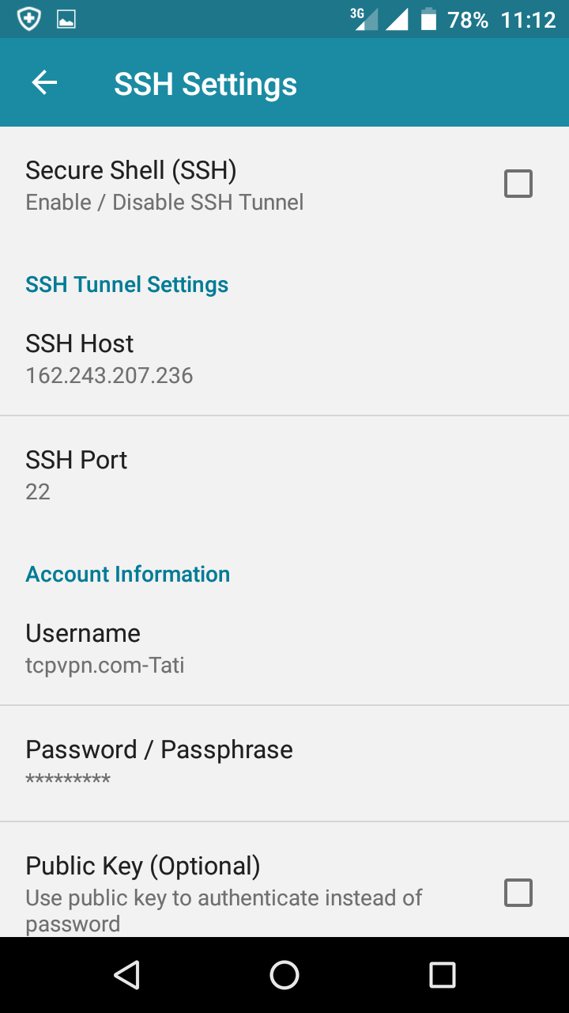
Note: lagi po Na 22 yung ssh port

Slide 5
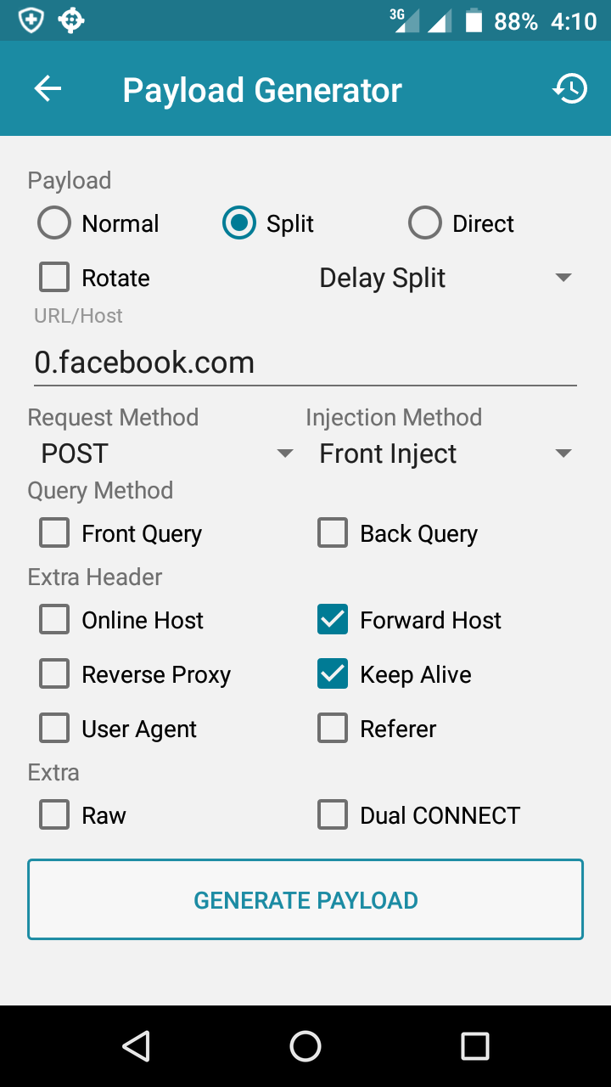
Ang payload ay
👉 0.facebook.com

Slide 6
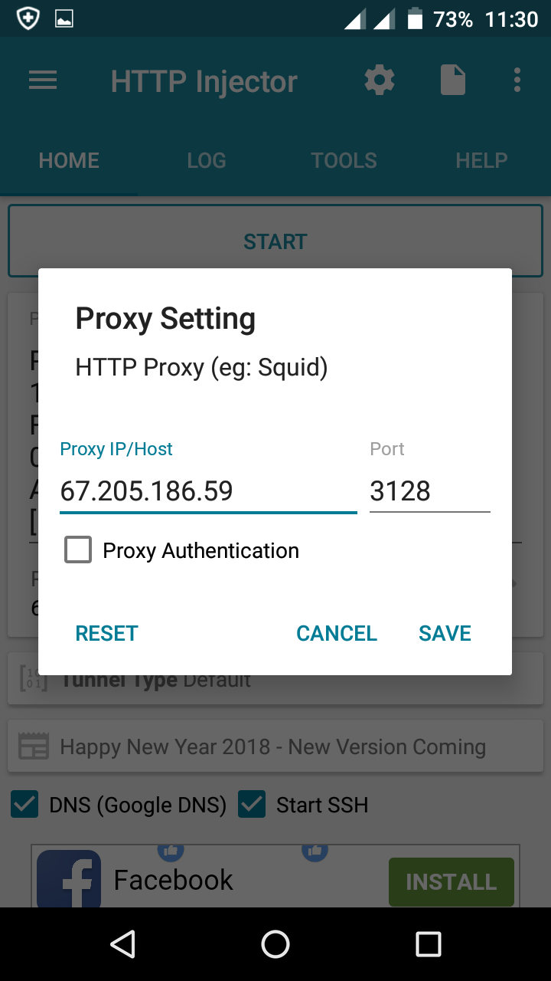
Proxy setting..

Slide 7
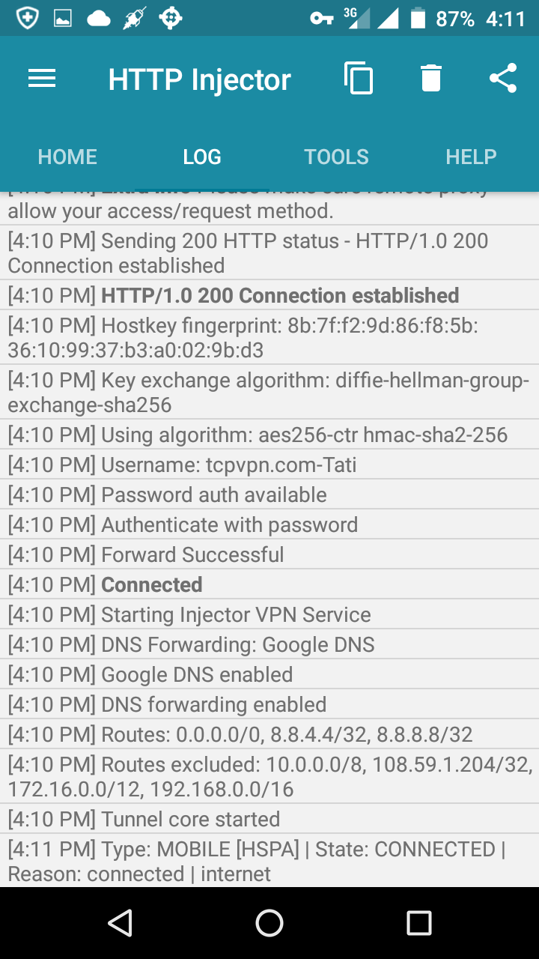
Heto Na sya😉 👍 👇👇

