Slide 1


ROTECH INSTITUTE OF TRADE INC.
Republic of the Philippines San Vicente, Gapan City, Nueva Ecija
MIC
Events Management Training Portfolio
Submitted by:
LAARNI M. IBARRA
Submitted to:
DR. GERSHOM CABURIAN
FAB EVENTS BY EL
San Lorenzo, Gapan City, Nueva Ecija Contact No. 0915-855-1607

Slide 2





Valmonte Street, San Lorenzo, Gapan City, Nueva Ecija Contact Number: 0915-855-1607

Slide 3

About Us
FAB events by EL is a full service event management firm based in Gapan City, Nueva Ecija that was managed by Mrs. Laarni M. Ibarra. She worked in abroad for 20 years as Secretary in a Investment company in Middle East. She decided to put up Events Management business because she was inspired by so many Events Coordinator abroad that she attended due to her job. Also she managed to create a small business and occasion events for her bosses and colleagues so that start her passion in creating a memorable events.
With the team of young, creative, dynamic and dedicated professionals, we make it our priority to understand our client’s objectives, working alongside clients from concept to completion to create a unique and memorable event.
We not only organize extravagant Event, we organize mesmerizing and fantastic moments for you. Because, Events may be forgotten but moments will last a lifetime. Whether you are looking for collective information about managing an event, we are eagerly waiting to lighten your events with our innovation. We offers complete event planning and management solutions.
Leave your event in the capable hands of the professionals. A place where the impossible becomes possible, where budget can become a desired outcome, and where dreams can become a reality.
We LISTEN, WE STRATEGIZE, We EXECUTE, WE SUCCEED
This is what makes FAB Events by EL different

Slide 4
VISION
MISSION
Our mission is to be a passionate, trusted and dedicated team of event planner
Our Vision is to become the most professional and experienced company in the event management industry We are committed to plan, deliver and execute our client’s unique vision.
professionals extraordinarily supply our management, unforgettable highest quality.
dedicated to providing flawless
events
that
clients with
faultless
style,
timeless experiences, and the

Slide 5
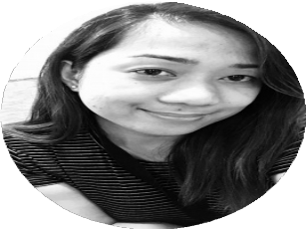
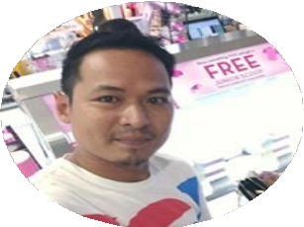


ORGANIZATIONAL CHART
Laarni M. Ibarra
General Manager
Darrel Ipurong
Finance
Mark De Guzman
Operation Manger

Slide 6
Event Coordinator/Owner
WORKING
COMMITTEE
Operations Manager
FINANCE
Marketing
Food
Decorations
Venue
Event Activities
Advertisin g
Menu/Dis play
Supplies/D écor Plan
Staging
Prizes/ Games

Slide 7




OUR SERVICES
Family Reunion
Entertainment
Birthday
Wedding
Conference
Other Events

Slide 8
LIST OF SUPPLIERS
SERVICES
HIGH-END
BUDGET FRIENDLY
Catering and Party Package | Shakeys | McDonalds
Clown, Puppet Show, Bubble Show, Face Painting | Papas Team | Bastis Party Ideas
Photo Booth | Casa de Fotographia | 3 Crayons PhotoBooth
Inflatables | Calebs Inplaytafun | Bounce 4 Joy
Dessert Buffet | Cakes Gourmet | Tins Sweet
Canvass DIY Materials | National Bookstore | Melodys

Slide 9
COVER LETTER TO CLIENT
15 March 2021
Ms. Angel San Pedro San Vicente, Gapan City, Nueva Ecija
0906-555-3496
Dear Ms. San Pedro,
I am writing this letter to you to present a business proposal, which is mutually beneficial for us. With the team of young, creative, dynamic and dedicated professionals, we make it our priority to understand our client’s objectives, working alongside clients from concept to completion to create a unique and memorable event. Kindly have a look at the enclosed event proposal for your daughter’ s 7th Birthday.
I believe the meeting will help to present the proposal to you so that you can also have better understanding of the quality and nature of our services.
Hope to hear from you soon.
Thank you again and we look forward to working with you to make your upcoming event an unforgettable experience.
Sincerely,
Mrs. Laarni M. Ibarra Owner
FAB Events by EL 0915-855-1607

Slide 10
LETTER TO CLIENT
01 April 2021
Ms. Angel San Pedro San Vicente, Gapan City, Nueva Ecija
0906-555-3496
Dear Ms. San Pedro,
We are so grateful for the pleasure of serving you on your daughter’s 7th Birthday. We, FAB Event by El is committed to providing first class service throughout the coordination and execution of your event. As we begin please see attached event proposal as a guide and resource for your knowledge and understanding of the facility procedures and policies and also a guideline is necessary to ensure a successful planning and event execution process.
Thank you again for trusting FAB Event by EL and we look forward to working with you to make your upcoming event an unforgettable experience.
Sincerely,
Mrs. Laarni M. Ibarra General Manager FAB Event by EL 0915-855-1607

Slide 11
LETTER TO SUPPLIER
26 March 2021
Ms. Roxane Esmino General Manager McDonalds Gapan Nueva Ecija
0915-542-5148
Dear Ms. Esmino,
I am writing this letter to request a business proposal with your company. I believe that your service will cater the needs of our Client. Your service are very popular with the kids. The event will take place on May 2, 2021. Our theme is a Princesses and Super Heroes. We are looking forward if you will accept our intention that we want your company to be part of our event.
I would highly appreciate meeting you at your convenience time to discuss this matter.
Please coordinate with us regarding your decision, you may contact us through this number (09556834674/ 09187872998).
Thank you in advance for your consideration. Yours Sincerely,
Mrs. Laarni M. Ibarra Owner
FAB Events by EL 0915-855-1607

Slide 12
CONTRACT WITH SUPPLIER
This agreement for event services is hereby entered into 5th Apr 2021 (Effective Date), by and between Ms. Roxanne Esmino (Manager) with an address of Walter Mart Bayanihan, Gapan City, Nueva Ecija(“The Client”) and FAB Events by EL with an address of San Lorenzo, Gapan City, Nueva Ecija (“The Planner”), collectively “the Parties”
1. Catering Services Provided. Client hires Caterer to Perform the following Catering Services:
Meal Package for Kids - 1pc Chicken Mcdo with Spaghetti, Regular Drink, Sundae & Happy Meal toy Meal Package for Adult - 1pc Chicken Mcdo with Spaghetti, Regular Drink, Sundae & Fries
Venue Decorations
Chairs & Tables
Sounds
Invitations, Balloons, Party Hat
Event Date & Description.
Event Date: 2 May 2021
Start Time & Location: 10:00am Walter Mart, Gapan City, Nueva Ecija
End Time: 2:00 pm
Payment. The Parties agree to the following Payment and Payment Terms:
Total fee for the services: 50% down payment upon signing of the contract Balance Due: One week before the date of event
IN WITNESS WHEREOF, The parties here executed this Contract on the dates set forth below accordance with the terms attached
ON BEHALF OF FAB EVENTS BY EL
ON BEHALF OF MCDONALDS
By:
Name:
BY:
NAME:

Slide 13
EVENT BRIEF
Event Title 7th Birthday
Theme Princesses and Super Heroes
Description In the party Guest can wear their favorite can grab a
Princesses and Super Heroes. Also they
DIY costumes enjoy party games, clowns, puppet show, bubble show, prizes,
gifts and many more surprises
Event Purpose To give the celebrant a memorable experience and let all the guest have fun
Client Mrs. Angel San Pedro Celebrant Laureen San Pedro
Date of Event Time of Event
May 2, 2021 10:00am
Number of Attendees 100
Total of Budget Projected Venue
Php 130,000
Waltermart, Gapan City, Nueva Ecija
Start Date End Date
April 1, 2021
May 3, 2021

Slide 14
REGULAR CLIENT
1st Birthday Mrs. Rufina Ucat OFW in Italy
Wedding
Mr. & Mrs. Erwin Romulado Seafarer
Christening
Mr. Arnel Rodriguez PNB Branch Manager

Slide 15
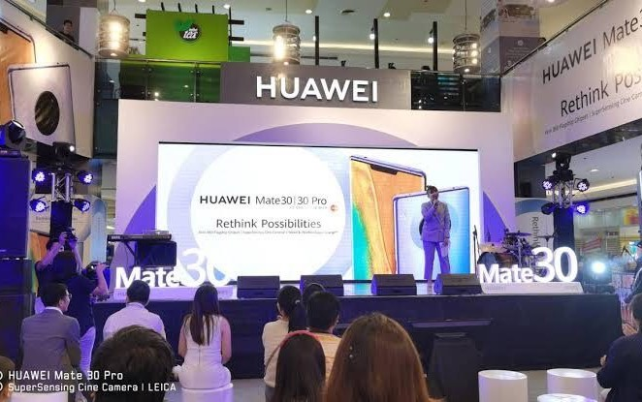
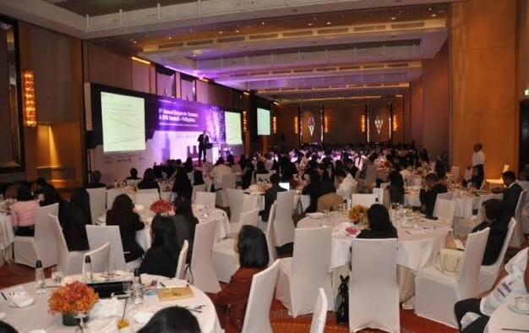
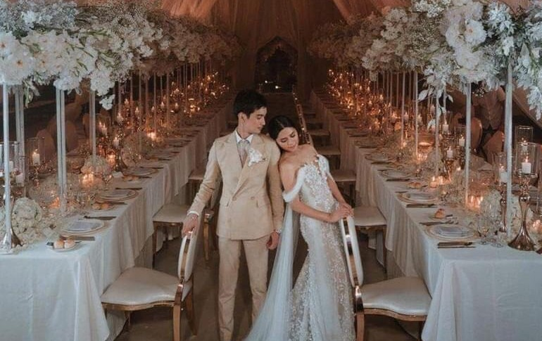
PREVIOUS CLIENT
Product Launch - Huawei
Corporate Events – SGV & Co Philippines
Weddings – Mr. & Mrs Noel Dela Cruz

Slide 16
CONTRACT TO CLIENT
This agreement for event services is hereby entered into 1st Apr 2021 (Effective Date), by and between Mrs. Angel San Pedro with an address of San Vicente, Gapan City, Nueva Ecija(“The Client”) and FAB Events by EL with an address of San Lorenzo, Gapan City, Nueva Ecija (“The Planner”), collectively “the Parties”
Event Date & Description. On May 2, 2021 Client intends to host the below described event (“the Event”): The coordinator will be able to set up a Princesses and Super Heroes Party, at 10:00am. The Event Coordinator will set up different kind of unique set up like DIY costumes, Laydown an indoor Rug, Picnic set up and inflatable bouncer, playground for kids. all the guest can enjoy the food and games.
Planner Duties. Clients engages Planners services to perform the following duties with regards to the event.
Catering Services
Cakes & sweets Buffet
Photo Booth
Clown, Face Painting, Bubble Show, Puppet Show
Invitations, souvenirs, balloons and tarpaulin
Tent/cushions/carpets
Inflatable playground for kids
Planner shall obtain Client approval, in writing, before entering into any binding contracts for the event and/or issuing any non-refundable deposits
3. Payment. The Parties agree to the following Payment and Payment Terms:
Total fee for the services: 15% of the total allocated budget Percentage due upon execution of Agreement: 50%
Balance Due: One week before the date of event
IN WITNESS WHEREOF, The parties here executed this Contract on the dates set forth below accordance with the terms attached
By:
Name:
BY:
NAME:

Slide 17
DETAILED BUDGET PROPOSAL
VENDOR | SERVICES | PARTICULARS | AMOUNT | TOTAL
Mc Donalds | Party Package Inclusions | 100 pax | 7,000.00
 | Themed Giveaways
 | Lights and sounds
 | Chairs, Tables, etc.
 | Hosting
 | Games
 | 1Gift for the Celebrant
 | Baloons
 | Mc Donald Mascot Appearance |  |  | 7,000.00
 | Food | 60 pax 195 | 11,700.00 | 11,700.00
 | Adult
 | 1pc Chicken Mcdo with Spaghetti Regular Drink, Sundae and Fries
 | Kids | 40 pax 208 | 8,320.00 | 8,320.00
 | 1 pc Chicken Mcdo with Spaghetti regular drink, Sundae and a Happy Meal Toy
 |  |  |  | 27,020.00
Tins Sweet | Dessert Buffet | 10 Candy Bars/Marshmallows 2 Dozen Donuts Choco Coated Fruits and Biscuits Cupcakes Cookies Cake Jars | 5,000.00 | 5,000.00

Slide 18
DETAILED BUDGET PROPOSAL
VENDOR | SERVICES | PARTICULARS | AMOUNT | TOTAL
3 Crayons Photo Booth | 2 Hours Photo Booth |  | 3,000.00 | 3,000.00
Team Papa's Clown | 1hr performance |  | 8,000.00
party needs | Face painting
 | Buble show
 | Puppet Show
 |  |  |  | 8,000.00
Melodys | DIY Materials |  | 5,000.00
 | Others |  | 2,000.00 | 7,000.00
Inflatable Playground |  |  | 10,000.00 | 10,000.00
Additional Prizes | Cash Prizes |  | 10,000.00 | 10,000.00
TOTAL EXPENSES |  | 97,040.00
CONTINGENCY FUND | 10% | 13,000.00
 |  | 110,040.00
PROFESSIONAL FEE | 15% | 19,500.00
GRAND TOTAL |  | 129,540.00

Slide 19
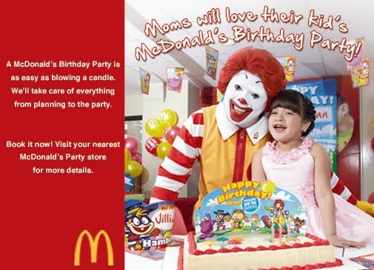
09:45-10:00
Arrival of the guest
Coordinator
Program Flow
(assist those who do not costumes can wear DIY)
wear
10:00-10:15
10:15-10:20
10:20-10:30
Start of the Event Opening Prayer Speech
Host
Host
Parents and celebrant
Papas Team
10:30-11:00
Magic Show
11:00-12:00 | Games for Kids and Adult
12:00-1:00 | Serving of Food/Open the Sweets Buffet & Photo Booth | McDonalds Tins Sweet
Papas
01:00-1:20 | Puppet Show | Papas Team
01:20-1:40 | Bubble Show | Papas Team
01:40-2:00 | Games | Host
Team
(Charade whispers, Longest Happy Birthday and more)
Closing Prayer and Speech Celebrant
02:00 pm

Slide 20
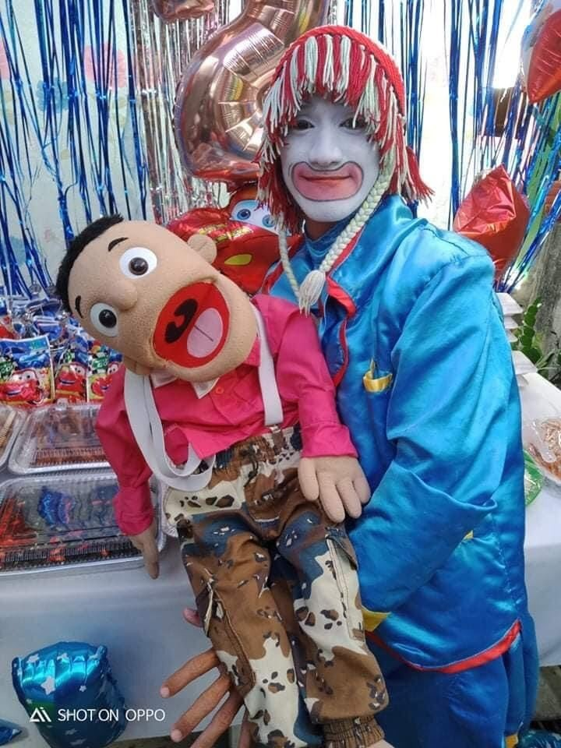
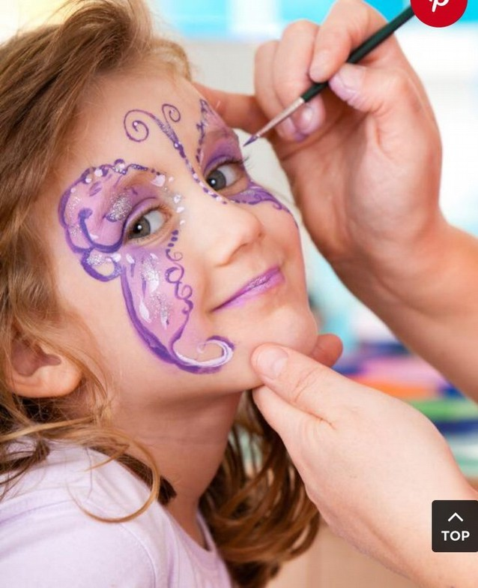
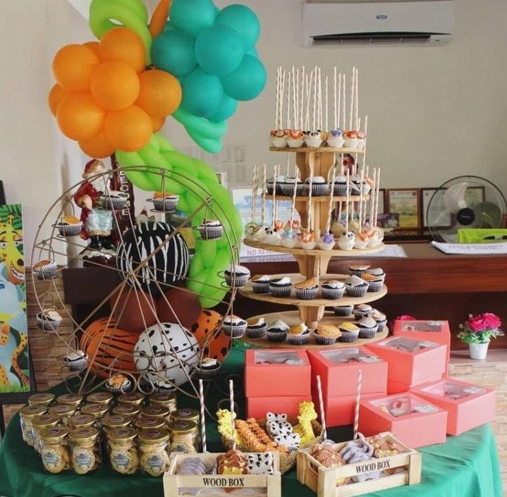

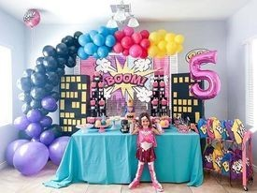
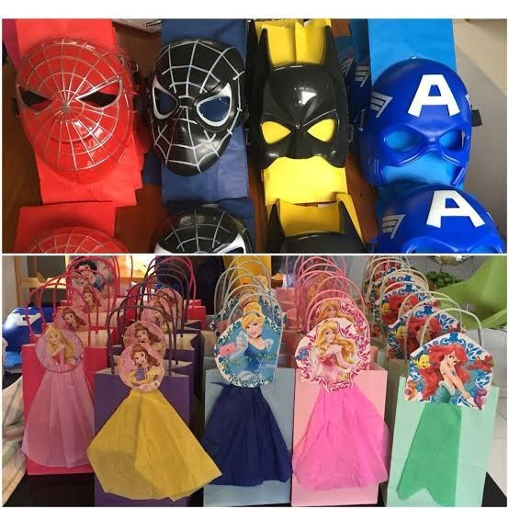
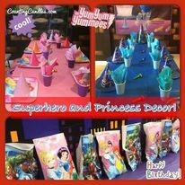

Slide 21
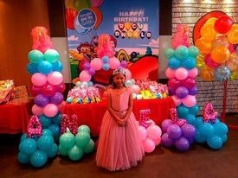

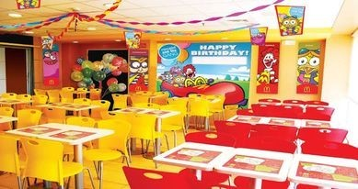

Slide 22
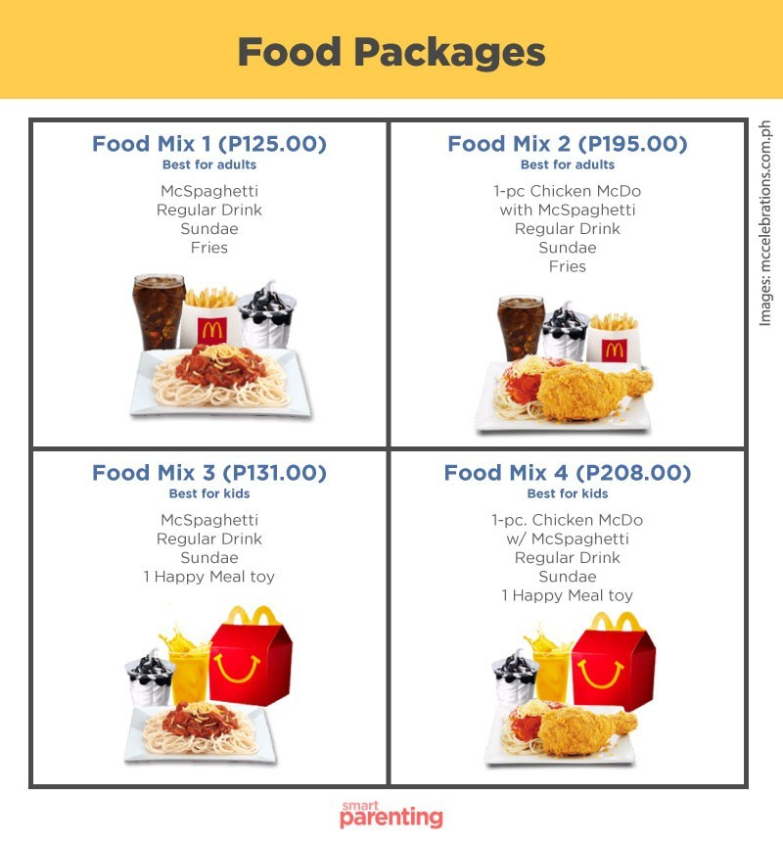

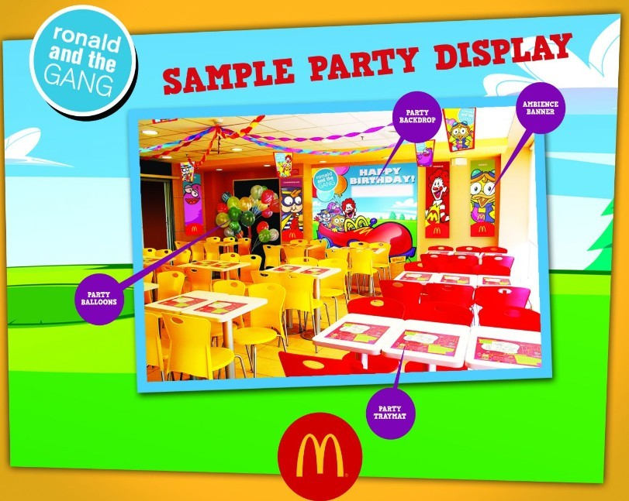
Party Package

Slide 23







Party Planning
INVITE
ADORN
E
Contract Signing to Client | 1 April 2021 ^{DANC}
Planning and preparations | April 06 – April 20, 2021
Meeting with Suppliers | March 30, 2021
Contract signing to Suppliers | April 5, 2021
Checking of Venue | April 24, 2021
Final meeting with the Client | April 28, 2021
Final Meeting with Working Committees | April 29, 2021

Slide 24
Risk and Discrepancies and Proposed Solutions
Possible Risk | Cause | Contingency Plan
Running Out of Food | Large Number of Unexpected Guest | Inform the food supplier in advance. / Use the Contingency Fund
Traffic | Emergency/Road Accidents | Advice the guest to come early in the venue especially for those who are far from the venue.

Slide 25

Food
Venue Decorations

Slide 26

DESSE RT BUFFE T
FIRE EXIT
STAGE
BUFF ET
PHOTO BOOTH
FACE PAINTI NG
AREA
PICNIC
PICNIC AREA
Inflata
ble
4 Seats Table
Tent (for one person only)
DIY
Costumes
SAFETY MEASURES
ENTRANCE

Slide 27

Thank You
Valmonte Street, San Lorenzo, Gapan City, Nueva Ecija Contact number: 0915-855-1607

