Slide 1

mUzikA
START

Slide 2
mUzikA
CATEGORIES
SETTINGS
QUIT

Slide 3
SETTINGS
SOUNDS

Slide 4
CATEGORIES
MODERN INSTRUMENT
TRADITIONAL INSTRUMENT
NOTES

Slide 5
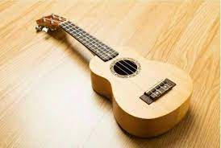
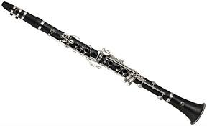
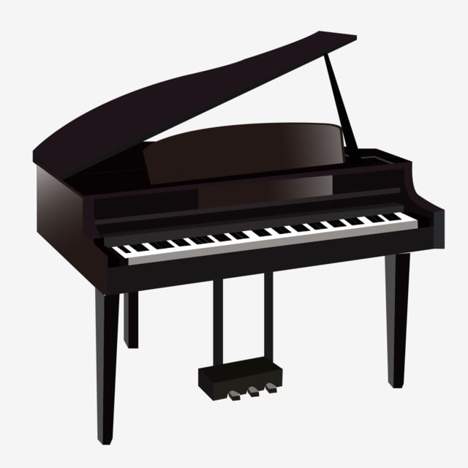
MODERN INSTRUMENT

Slide 6

LEVEL 1
UKULELE
is known for its small size, typically ranging from about 20 to 30 inches in length. It has a hollow body with a sound hole, a fretted fingerboard, and usually comes in four main sizes: soprano, concert, tenor, and baritone.
VIOLIN
GUITAR
Kilala ito sa maliit nitong sukat, karaniwang umaabot mula 20 hanggang 30 pulgada ang haba. Ito ay may butas na tunog sa katawan, may nakakapit na fingerboard, at karaniwang may apat na pangunahing sukat: soprano, concert, tenor, at baritone.

Slide 7
LEVEL 2
PIANO
is a musical instrument that belongs to the keyboard family. It is played by pressing keys, which then cause hammers to strike strings inside the instrument, producing sound.
DRUMS
FLUTE
Ito ay isang instrumentong pangmusika na kabilang sa pamilya ng keyboard. Ito ay nilalaro sa pamamagitan ng pagpindot sa mga key, na siya namang nagpapabangga sa mga martilyo sa loob ng instrumento, na nagreresulta sa tunog.

Slide 8
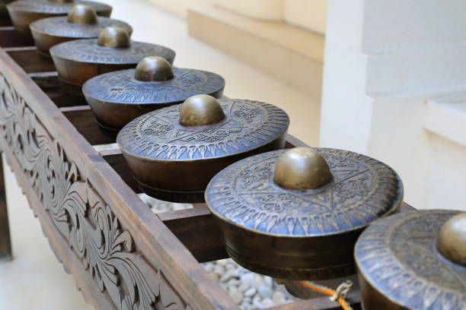
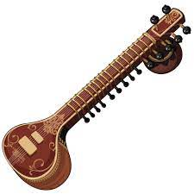
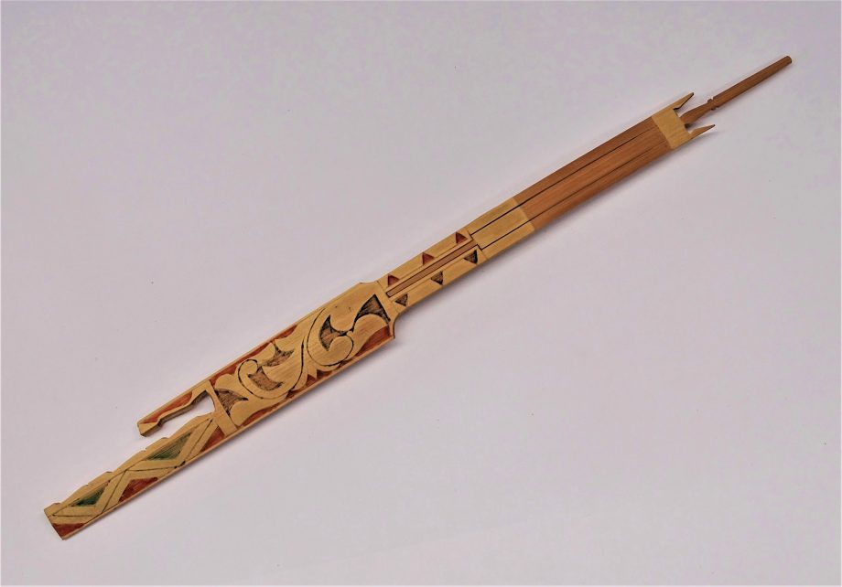
TRADITIONAL INSTRUMENT

Slide 9
LEVEL 1
KUBING
KULINTANGAN
ls known as the jaw harp or bamboo mouth harp, is a small, handheld instrument made from a single piece of bamboo or metal. It is found across various regions of the Philippines and is played by indigenous communities.
SHAMISEN
Kilala ito bilang kubing o bungkaka, isang maliit na instrumento na hawak-hawak na gawa sa isang pirasong kawayan o metal. Matatagpuan ito sa iba't ibang rehiyon ng Pilipinas at nilalaro ng mga katutubo.

Slide 10
NOTES
HALF NOTE
QUAVER
WHOLE NOTE
CROTCHET
BREVE
SEMI QUAVER
DEMISEMIQUAVER
HEMIDEMISEQUAVER

Slide 11

HALF NOTE
A half note is a musical note that represents a specific duration of time in Western musical notation. It is also known as a minim in British English. In terms of rhythmic value, a half note is generally held for half the duration of a whole note.

