Slide 1
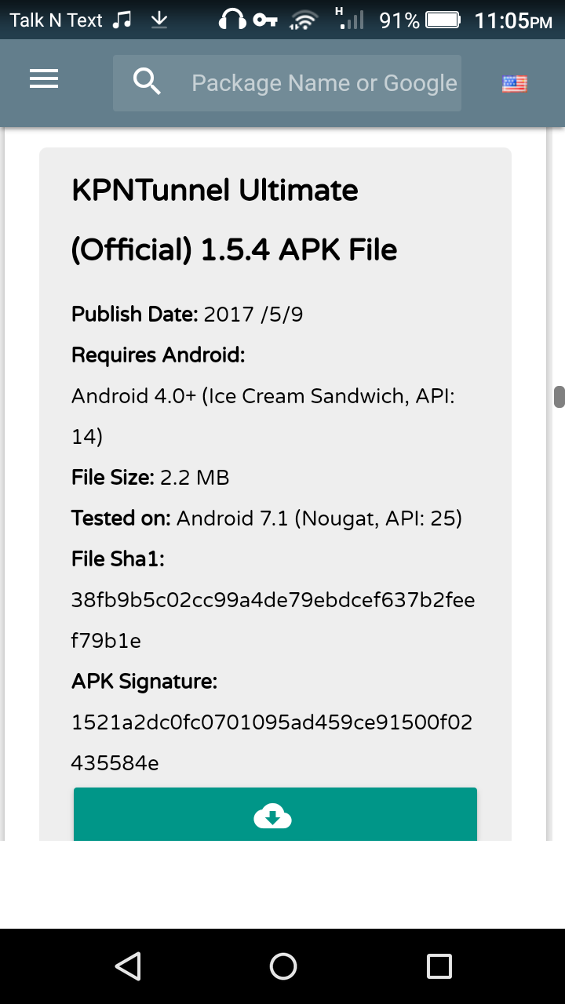
KPNTUNNEL ULMATE CONFIGURATION

