Slide 1

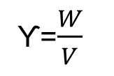
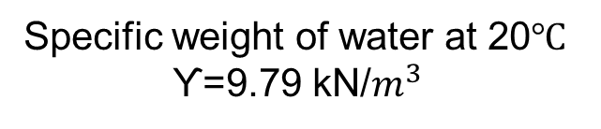
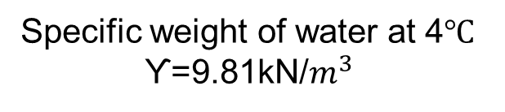
CHAPTER 1: PROPERTIES OF FLUIDS
SPECIFIC WEIGHT
Specific weight=
ϒ=
Specific weight of water at 20
ϒ=9.79 kN/
Specific weight of water at 4
ϒ=9.81kN/

Slide 2



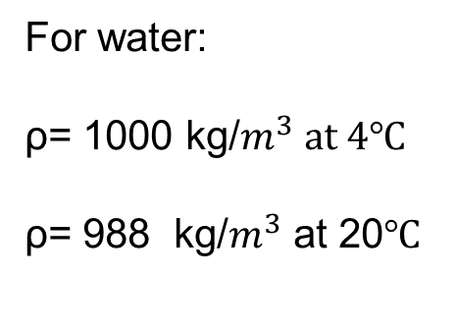


Mass density=
ρ=
ρ= kg/ or slugs/ For water:
ρ= 1000 kg/
ρ= 988 kg/ at 20℃
m= m=

Slide 3



Specific volume=
Specific volume=
Specific volume= /kg or /slugs

Slide 4
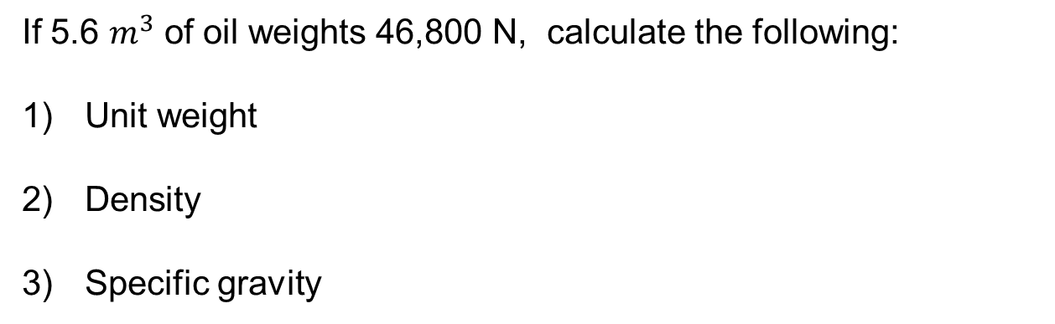
Problem: 1
If 5.6 of oil weights 46,800 N, calculate the following:
Unit weight
Density
Specific gravity

Slide 5
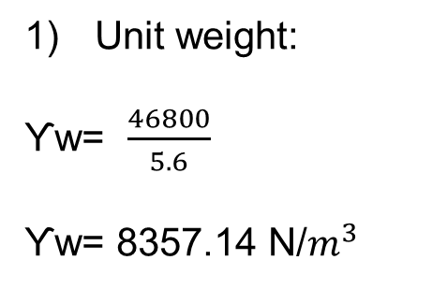
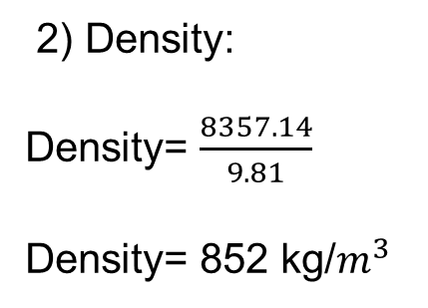
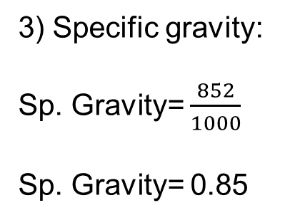
Solution:
1) Unit weight:
ϒw=
2) Density:
Density=
ϒw= 8357.14 N/
Density= 852 kg/
3) Specific gravity:
Sp. Gravity=
Sp. Gravity= 0.85

Slide 6
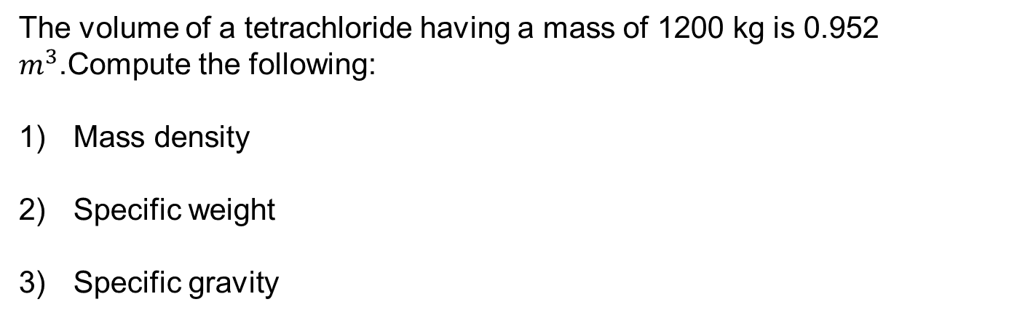
Problem: 2
The volume of a tetrachloride having a mass of 1200 kg is 0.952
.Compute the following:
Mass density
Specific weight
Specific gravity

Slide 7
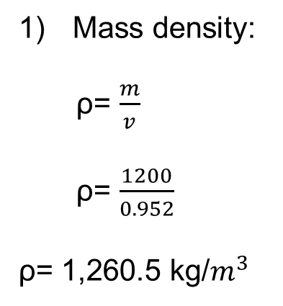
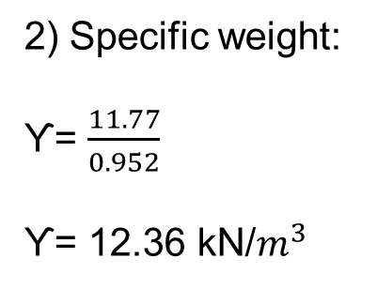
Solution:
Weight= 1200 (9.81)
Weight= 11772 N
Weight= 11.77 kN
1) Mass density:
2) Specific weight:
ρ=
ϒ=
ρ=
ϒ= 12.36 kN/
ρ= 1,260.5 kg/

Slide 8
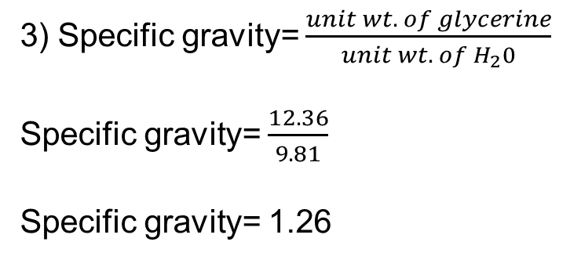
3) Specific gravity=
Specific gravity= Specific gravity= 1.26

Slide 9
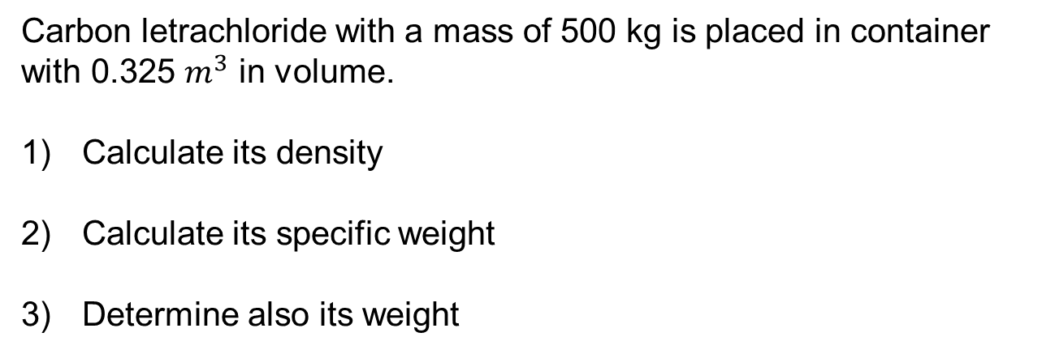
Problem 3:
Carbon letrachloride with a mass of 500 kg is placed in container with 0.325 in volume.
Calculate its density
Calculate its specific weight
Determine also its weight

Slide 10
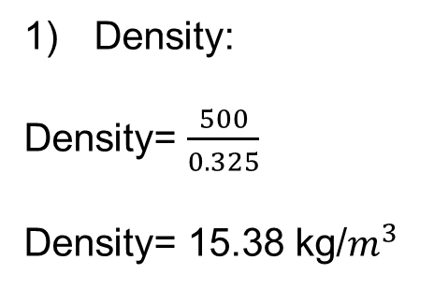
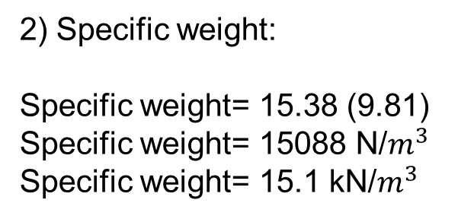
Solution:
1) Density:
Density=
2) Specific weight:
Specific weight= 15.38 (9.81) Specific weight= 15088 N/ Specific weight= 15.1 kN/
Density= 15.38 kg/
3) weight= 15.1 (0.325)
Weight= 4.9 kN

Slide 11
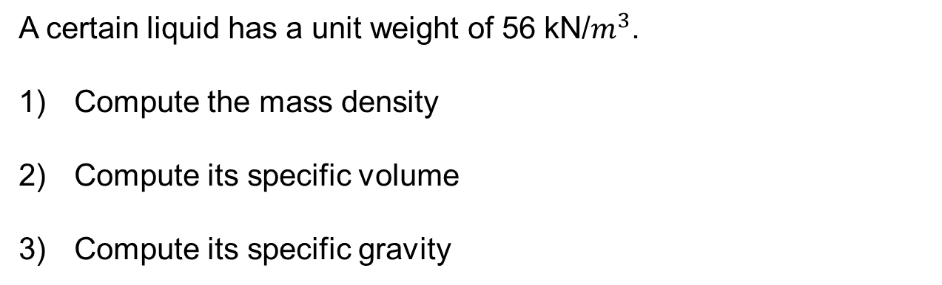
Problem 4:
A certain liquid has a unit weight of 56 kN/.
Compute the mass density
Compute its specific volume
Compute its specific gravity

Slide 12
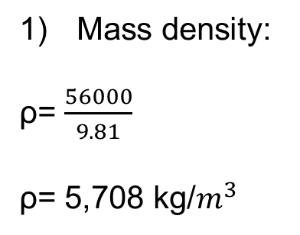
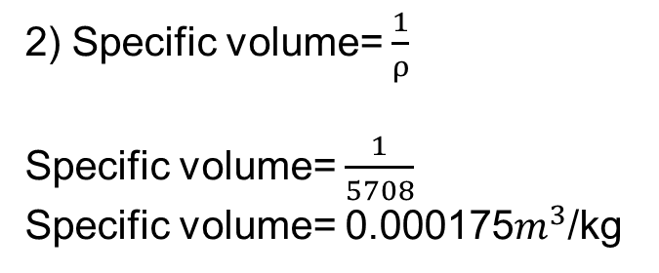
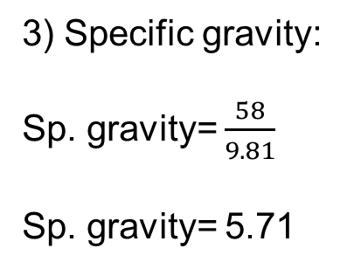
Solution:
1) Mass density:
2) Specific volume=
ρ=
Specific volume=
Specific volume= 0.000175/kg
ρ= 5,708 kg/
3) Specific gravity:
Sp. gravity=
Sp. gravity= 5.71

Slide 13
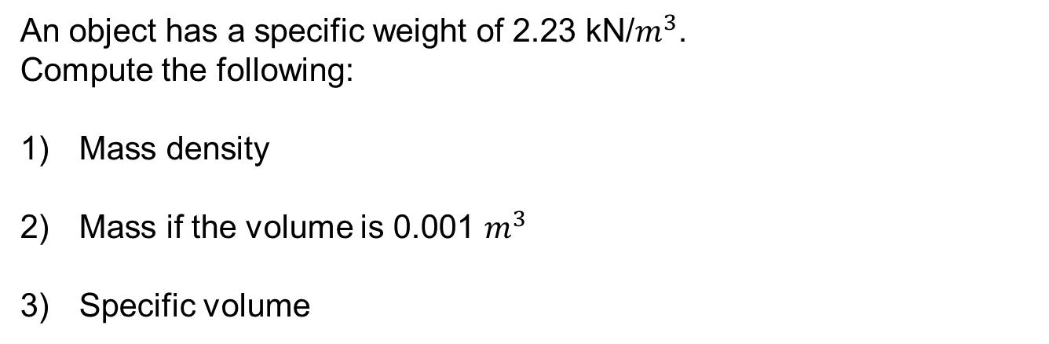
Problem 5:
An object has a specific weight of 2.23 kN/. Compute the following:
Mass density
Mass if the volume is 0.001
Specific volume

Slide 14
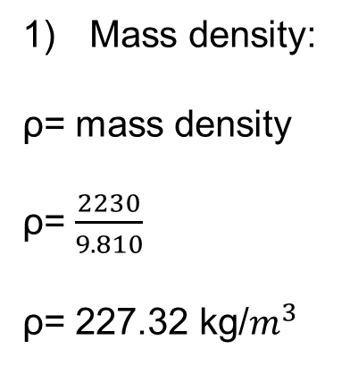
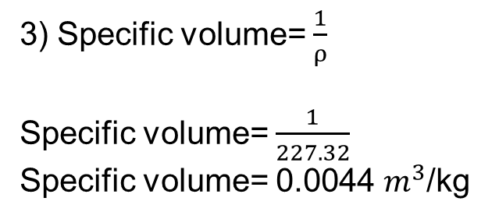
Solution:
1) Mass density:
ρ= mass density
2) M= ρ Vol.
M= 227.32 (0.001)
M= 0.23 kg
ρ=
ρ= 227.32 kg/
3) Specific volume= Specific volume=
Specific volume= 0.0044 /kg

Slide 15
Problem 6:
A quart of water weights 4.08 lb. Compute the following:
Mass in slugs
Mass in kg
Volume in cu.ft

Slide 16
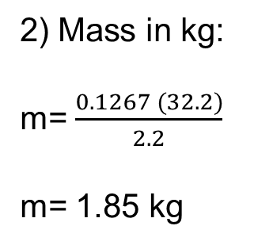
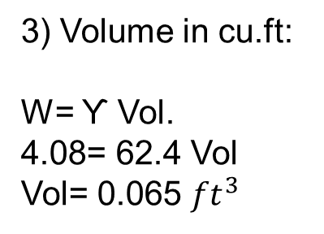
Solution:
1) Mass in slugs:
W= mg
4.08= m(32.2)
m= 0.1267 slugs
2) Mass in kg:
m=
m= 1.85 kg
3) Volume in cu.ft:
W= ϒ Vol. 4.08= 62.4 Vol
Vol= 0.065

Slide 17
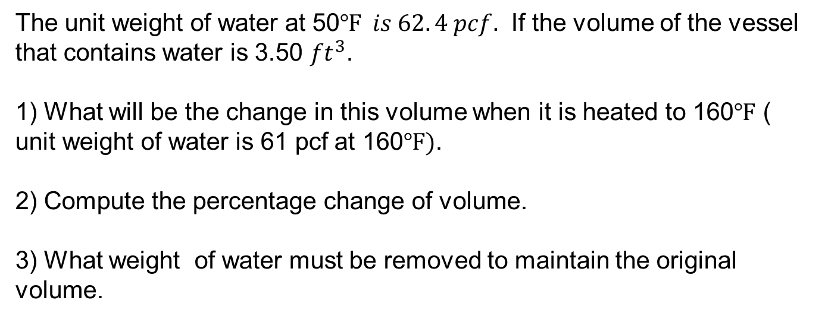
Problem 7:
The unit weight of water at 50 If the volume of the vessel that contains water is 3.50 .
What will be the change in this volume when it is heated to 160 ( unit weight of water is 61 pcf at 160.
Compute the percentage change of volume.
What weight of water must be removed to maintain the original volume.

Slide 18
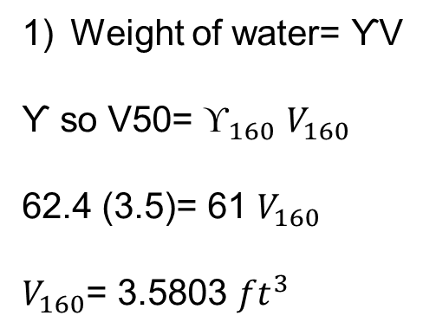
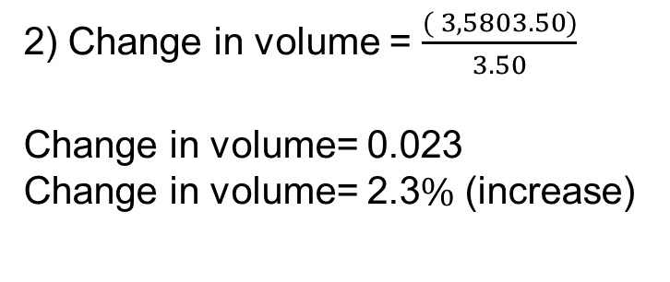
Solution:
1) Weight of water= ƳV
2) Change in volume =
Ƴ so V50=
Change in volume= 0.023 Change in volume= 2.3 (increase)
62.4 (3.5)= 61
= 3.5803
3) wt. of water that must be removed
= (3.5803 – 3.5 ) (61)
= 4.90 lb.

Slide 19
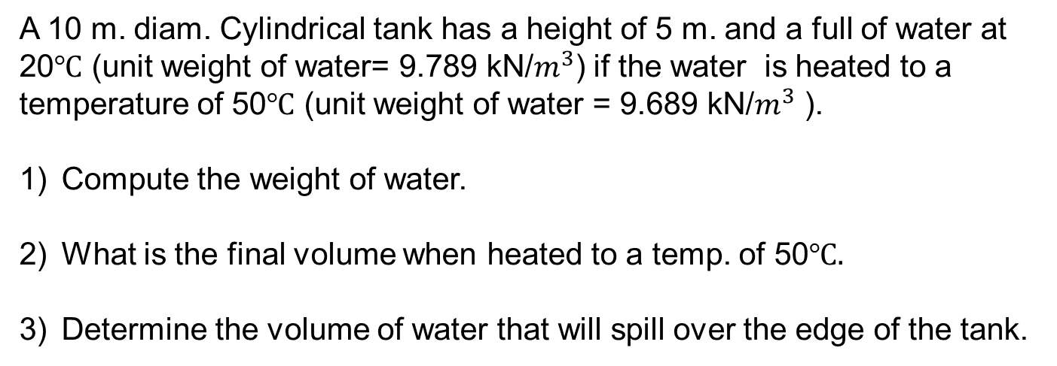
Problem 8:
A 10 m. diam. Cylindrical tank has a height of 5 m. and a full of water at 20 (unit weight of water= 9.789 kN/) if the water is heated to a temperature of 50 (unit weight of water = 9.689 kN/ ).
Compute the weight of water.
What is the final volume when heated to a temp. of 50
Determine the volume of water that will spill over the edge of the tank.

Slide 20
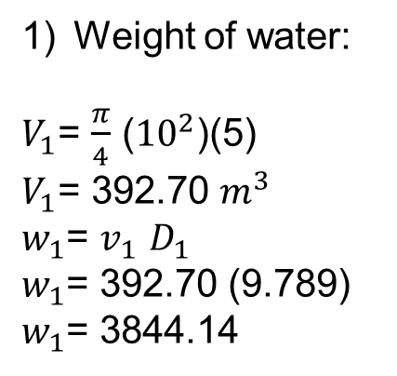
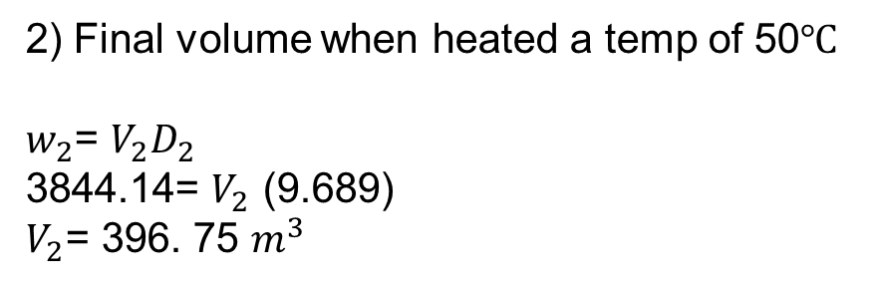
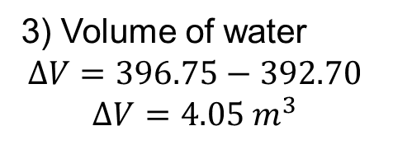
Solution:
1) Weight of water:
2) Final volume when heated a temp of 50
= ()(5)
= 392.70
=
= 392.70 (9.789)
= 3844.14
=
3844.14= (9.689)
= 396. 75
3) Volume of water

Slide 21
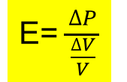
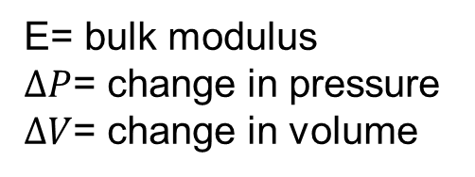
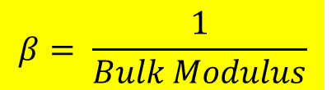
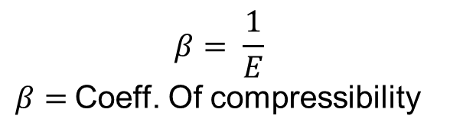
BULK MODULUS
BULK MODULUS OF WATER
E=
E= bulk modulus
= change in pressure
= change in volume
COEFFICIENT OF COMPRESSIBILITY
₌ 1
Coeff. Of compressibility

Slide 22
Problem 9:
A liquid which is compressed in a cycle if it has a volume of 1000 cu. cm (1 liter) at 2MPa and a volume of 990 cu. cm at 2.5 Mpa.
Compute the bulk modulus of elasticity.
Compute the percentage of volume decreased.
Compute the coefficient of compressibility.

Slide 23
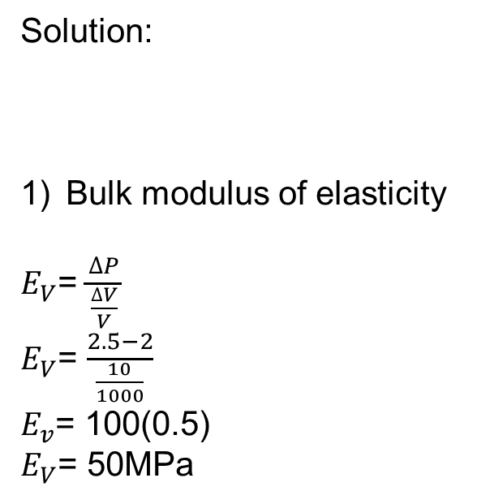
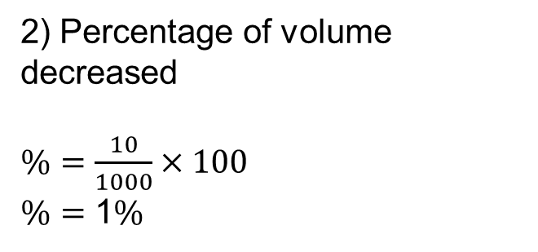
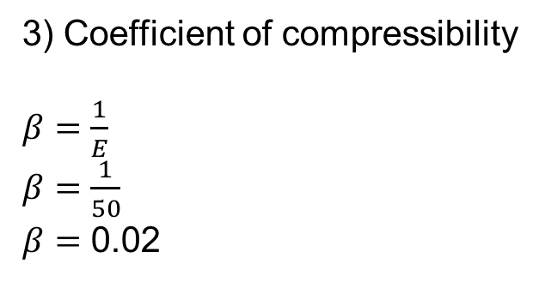
Solution:
1) Bulk modulus of elasticity
2) Percentage of volume decreased
=
=
= 100(0.5)
= 50MPa
1
3) Coefficient of compressibility
0.02

Slide 24
Problem 10:
A volume of one cu. Meter of water is subjected to a pressure increase of 14 MPa.
Compute the change in its volume if it has a bulk modulus of elasticity of 2200 MPa.
Compute the percentage of volume decreased.
Compute the coefficient of compressibility.

Slide 25
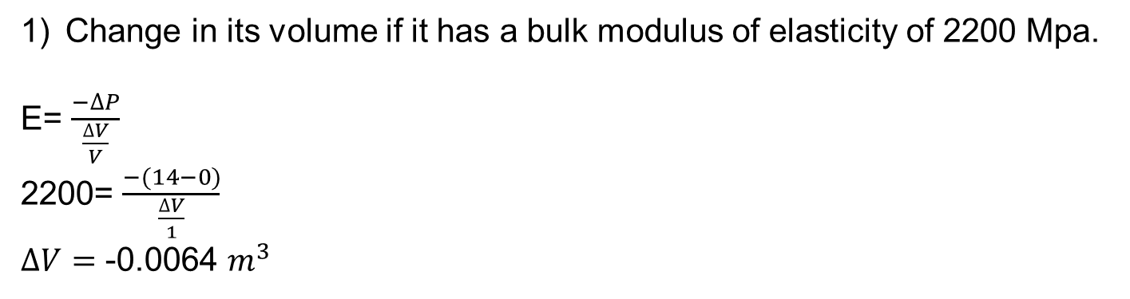
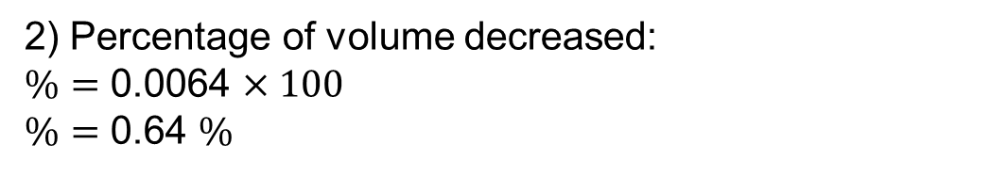
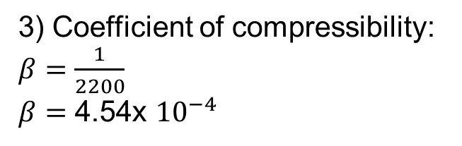
Solution:
1) Change in its volume if it has a bulk modulus of elasticity of 2200 Mpa.
E= 2200=
-0.0064
Percentage of volume decreased: 0.0064
0.64
Coefficient of compressibility: 4.54x

Slide 26
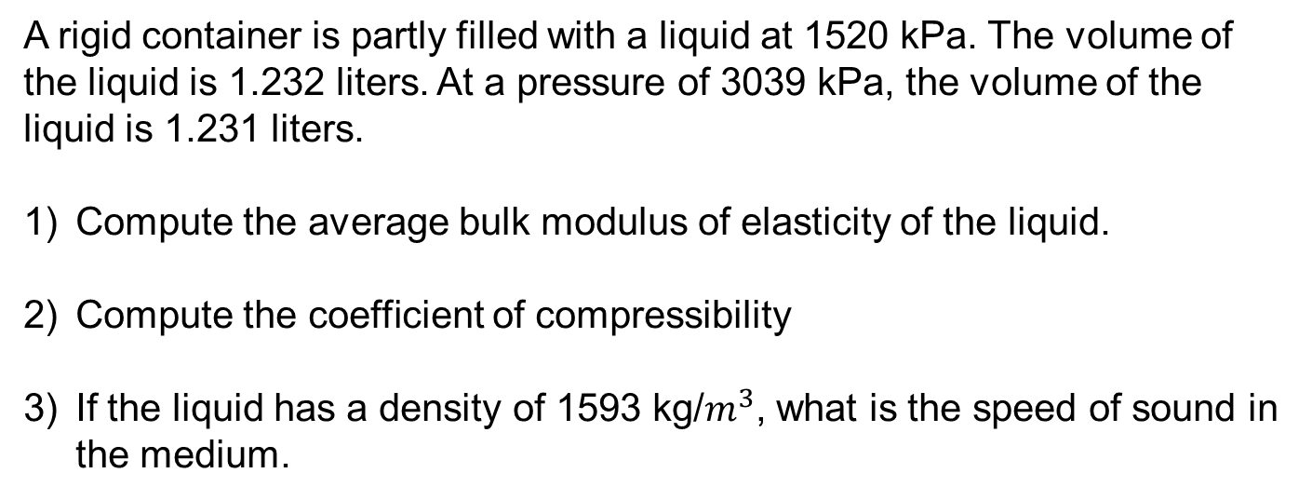
Problem 10A :
A rigid container is partly filled with a liquid at 1520 kPa. The volume of the liquid is 1.232 liters. At a pressure of 3039 kPa, the volume of the liquid is 1.231 liters.
Compute the average bulk modulus of elasticity of the liquid.
Compute the coefficient of compressibility
If the liquid has a density of 1593 kg/, what is the speed of sound in the medium.

Slide 27
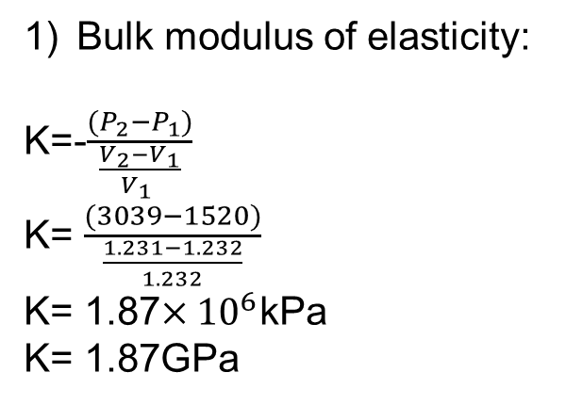
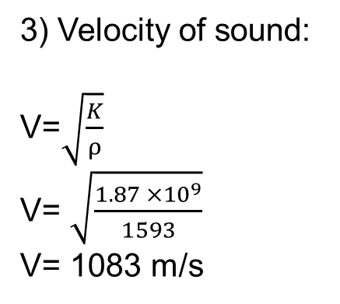
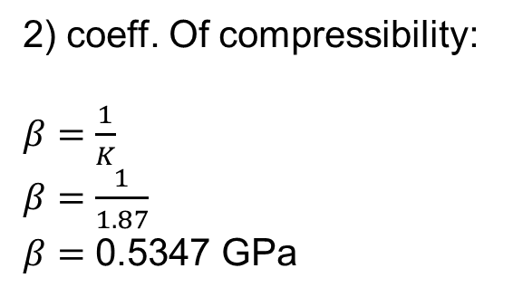
Solution:
1) Bulk modulus of elasticity:
3) Velocity of sound:
K=- K=
K= 1.87kPa K= 1.87GPa
V= V=
V= 1083 m/s
2) coeff. Of compressibility:
0.5347 GPa

Slide 28
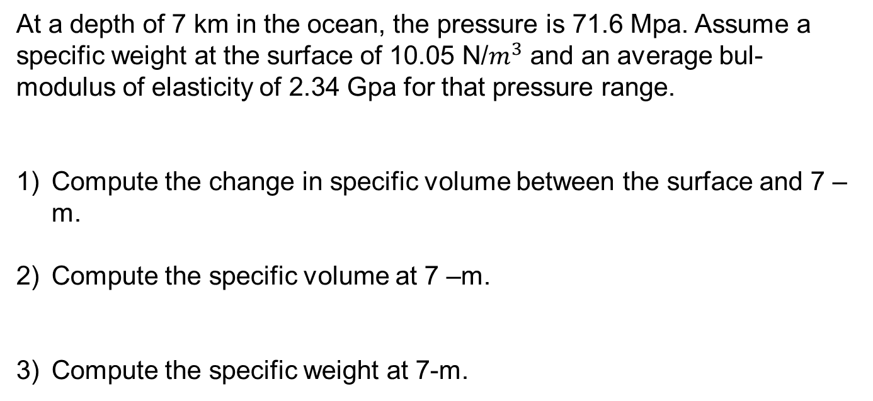
Problem 10-B :
At a depth of 7 km in the ocean, the pressure is 71.6 Mpa. Assume a specific weight at the surface of 10.05 N/ and an average bul- modulus of elasticity of 2.34 Gpa for that pressure range.
Compute the change in specific volume between the surface and 7 – m.
Compute the specific volume at 7 –m.
Compute the specific weight at 7-m.

Slide 29
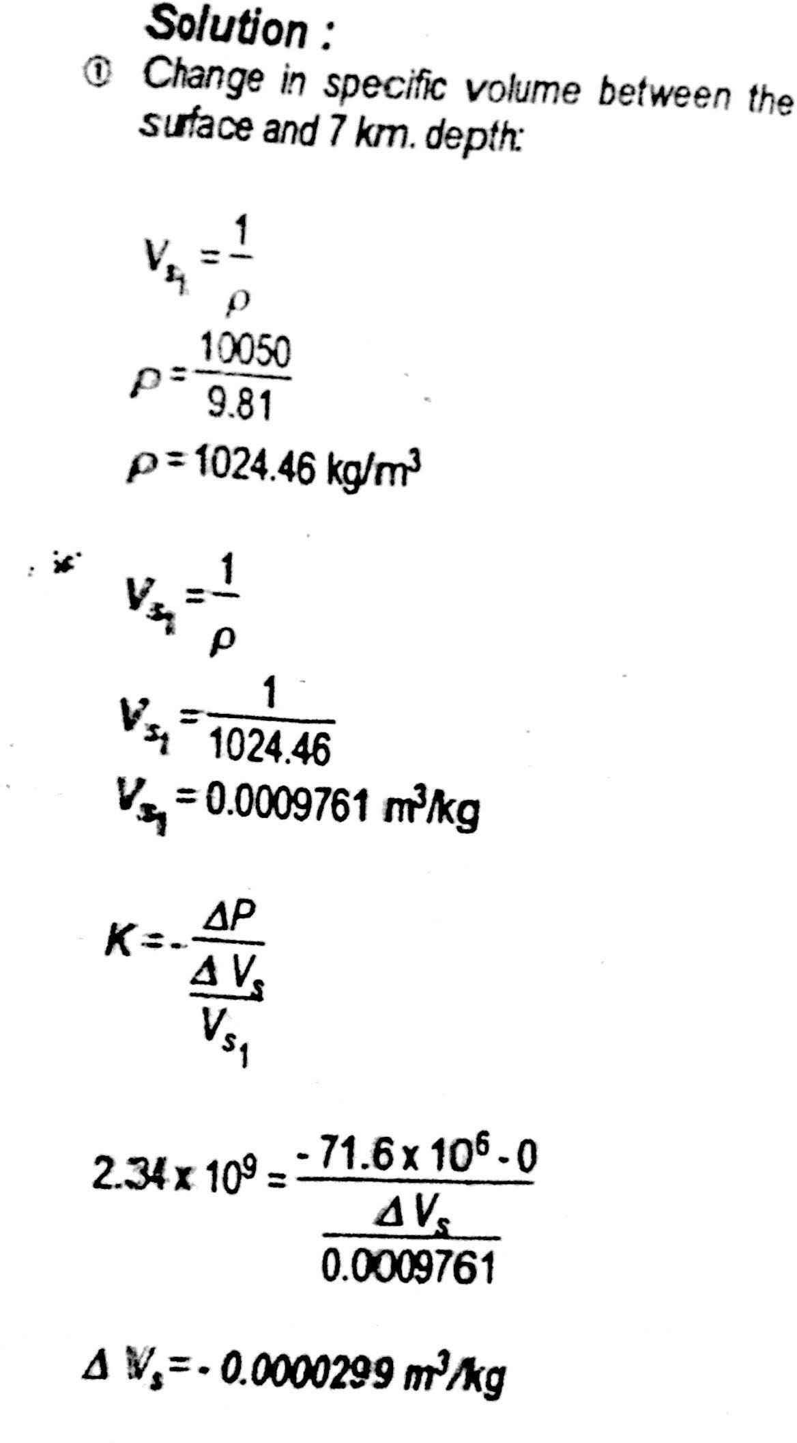

Slide 30
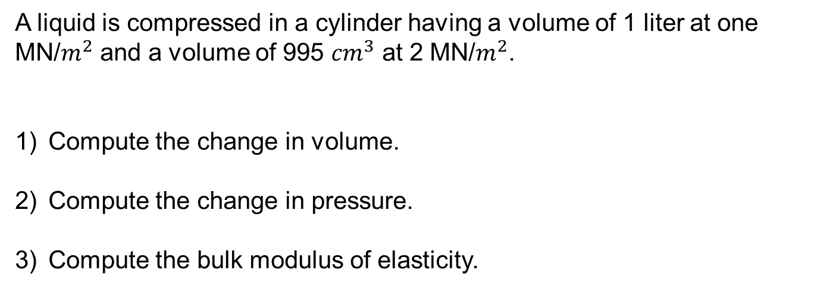
Problem 11
A liquid is compressed in a cylinder having a volume of 1 liter at one MN/ and a volume of 995 at 2 MN/.
Compute the change in volume.
Compute the change in pressure.
Compute the bulk modulus of elasticity.

Slide 31
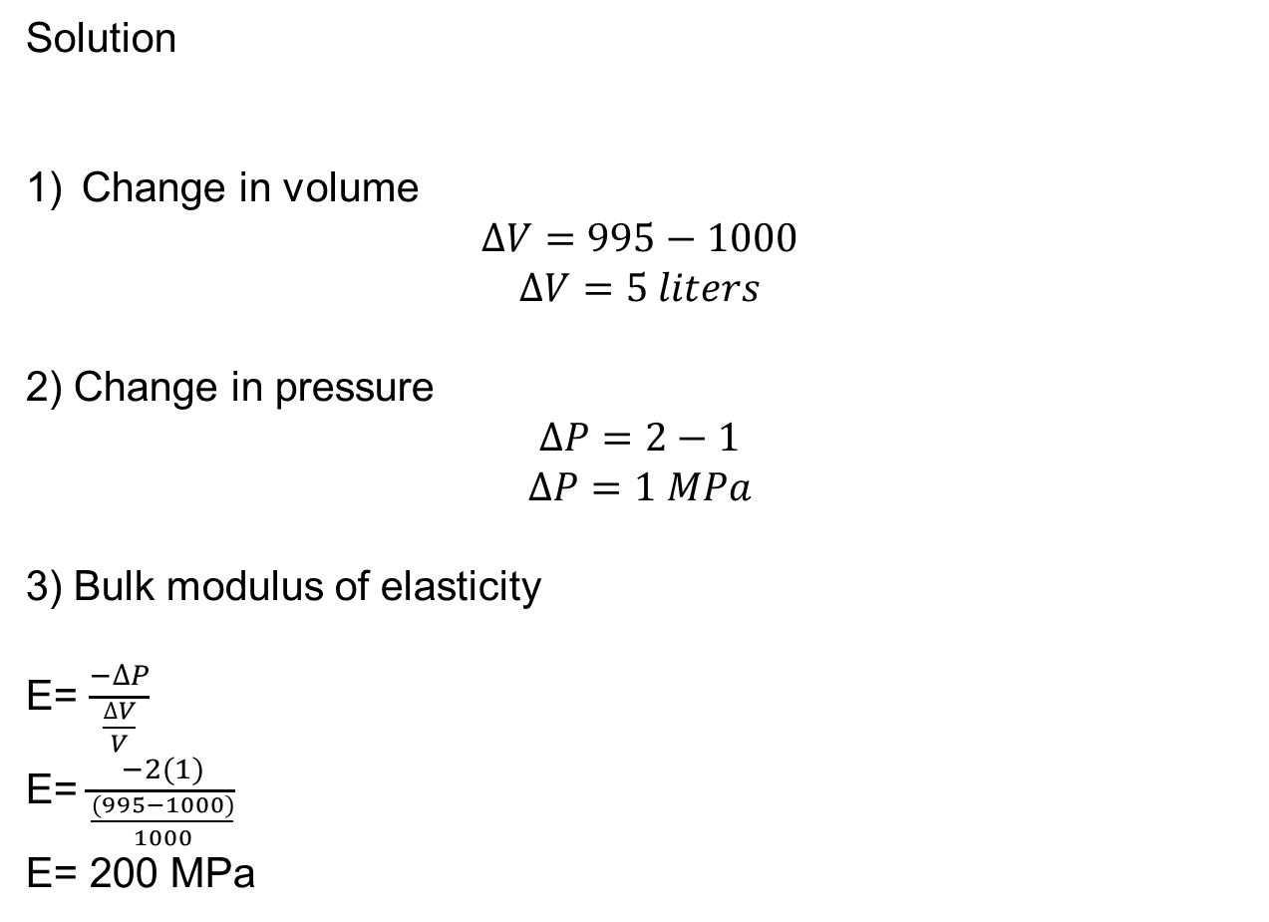
Solution
1) Change in volume
2) Change in pressure
3) Bulk modulus of elasticity
E= E=
E= 200 MPa

Slide 32
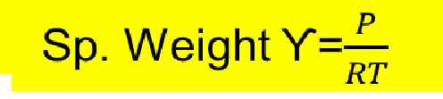

SPECIFIC WEIGHT OF AIR AND GASSES
Specific weight of air and gases
Sp. Weight ϒ=
P= absolute pressure
T= absolute temperature in kelvin or rankine
R=
T= 460 rankine R= gas constant

Slide 33

Problem 12
A gas having a volume of 1 liters has a pressure of 0.24 MPa at 20 If the gas constant R is equal to 212 N/kg.k compute
Density of the gas
Mass of the gas
Weight of gas

Slide 34

Solution
p=
T= 273
T= 273 + 24
T= 297
p=
p= 3.81 kg/
m= pV
m= 3.81(0.04)
m= 0.152 kg
W= Mg
W= 0.152(9.81)
W= 1.49 N

Slide 35

Problem 13
A gas is under pressure of 21. 868 bar abs at 40.
Compute the pressure in kPa
Compute the gage pressure.
Compute the gas constant R if it has a unit weight of 362 N/

Slide 36

Solution
Pressure in kPa P= 21.868 (100) P= 2186.8 kPa abs
Gage pressure
+
2186.8 = + 101.3
= 2085.5 kPa
Gage constant R
ϒ=g
P= 21.868 x kPa
Note
1 bar= kPa = 100 kPa
362= (9.81) R= 189.3/ft

Slide 37
Problem 14
1) What is the difference in pressure between the inside and outside of a bubble having a diameter of 0.003 in if it is equivalent to an airwater interface having a surface tension of
0.005 lb/ft.
Compute the pressure in kPa
Compute the force due to surface tension.

Slide 38

Solution
Difference in pressure P=
P= 80 psf
Pressure in kPa P= 80 )()
P= 3.83 kPa
Force due to surface tension F= )0.005
F= 3.93 x

Slide 39


Problem 15
The radius of the tube as shown in the figure is 1 mm. the surface tension of water at 20 is equal to 0.0728 N/m. For a water glass interface
Compute the capillary rise in the tube in mm
Compute the total force due to surface tension
Compute the weight of water above the surface due to surface tension

Slide 40

Solution
Capillary rise in the tube mm h=
h=
h= 14.8 mm
Total force due to surface tension F=
F= 0.0728(2 F= 4.57 x N
Weight of water
W=yVol= 9810 (0.00(0.0148) W= 4.56 x N

Slide 41

Problem 16
Find the depression h of the mercury in the glass capillary tube having diameter of 2 mm if the surface tension is 0.514 N/m for
Compute the force caused by surface tension.
Determine the density of mercury.

Slide 42

Solution
h= p=
p= 13600 kg/
Depression h h= 5.9 mm
Force caused by surface tension F=
F= 0.154 F= 2.47 x N
Density of mercury P= 13600 kg/

Slide 43

Problem 17
Determine the surface tension in a tube with 0.2 m radius and wetting angle and capillary rise of 5 mm.
Determine the surface tension in lb/ft
If wetting angle =80, determine the surface tension.

Slide 44

Solution
Surface tension in a tube h=
0.005 =
(surface tension)
Surface tension in lb/ft ()()
= 0.34 lb/ft
Surface tension
0.005 =
= 28.25 N/m

