Slide 1
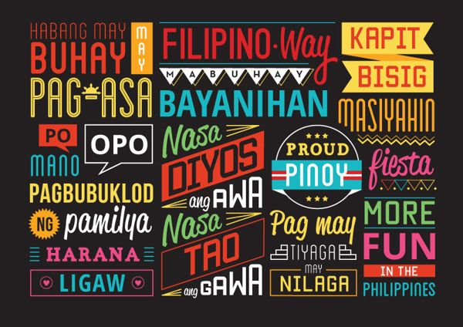

Slide 2

Learning Objectives:
At the end of the lesson, learners should be able to:
1. Analyze crucial qualities of the Filipino moral identity in their own moral experience.
2. Appreciate Filipino values
3. Evaluate elements that need to be changed.

Slide 3
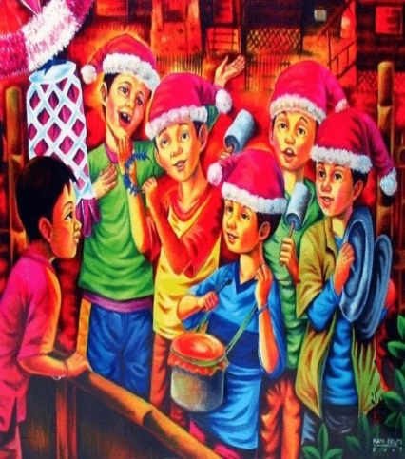
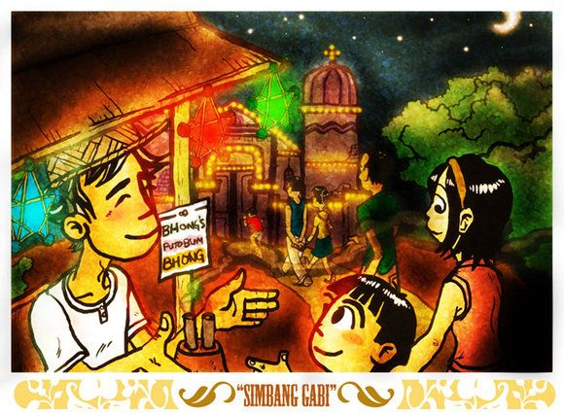
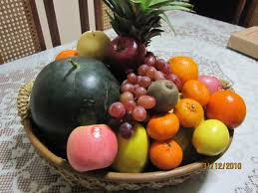
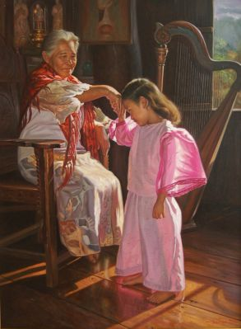

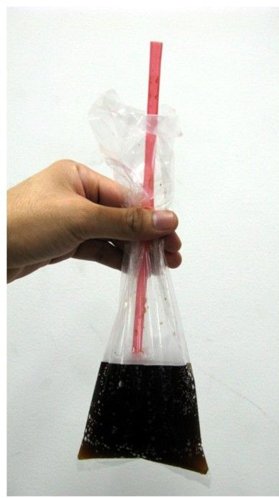
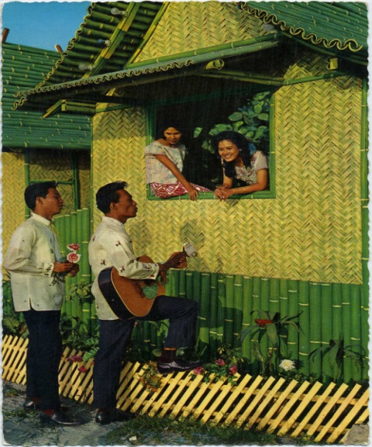
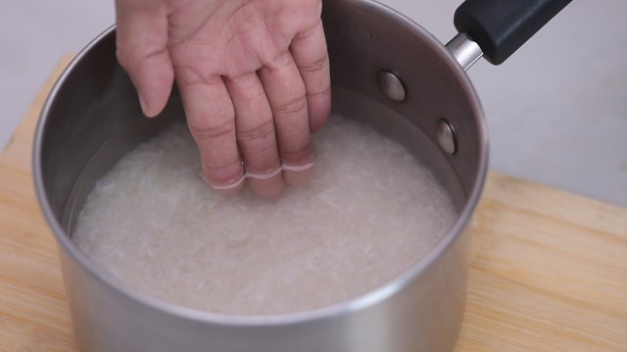
The Filipino Customs and Tradition
Culture makes the Philippines different from the rest of the world

Slide 4
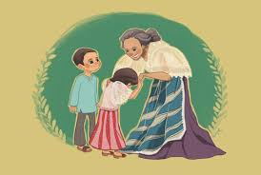

‘Mano po’- term used when kissing the hand of the elder.
‘Mano’-Spanish word for hand
‘po’- used at the end of the sentence to address the elders or superiors.

Slide 5
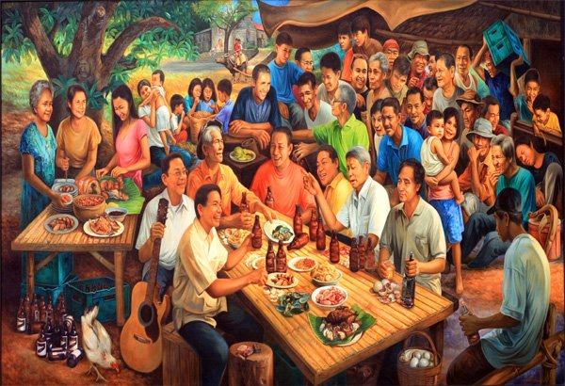
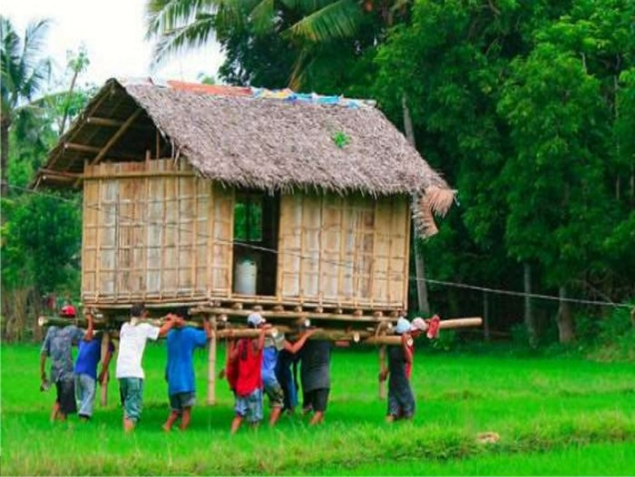
1. Close family ties-one unique traits and outstanding cultural values that Filipino have. Having fondness for family reunions during secular and religious holidays.
2. The bayanihan -spirit of communal unity or effort to achieve a particular objective. People nowadays use it to describe an outpouring of community spirit—as people give their common good, without expecting recognition or personal gain.

Slide 6
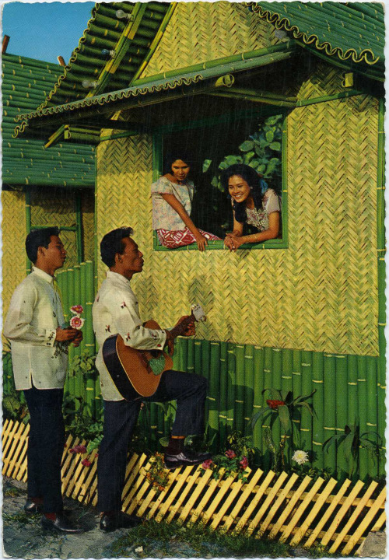
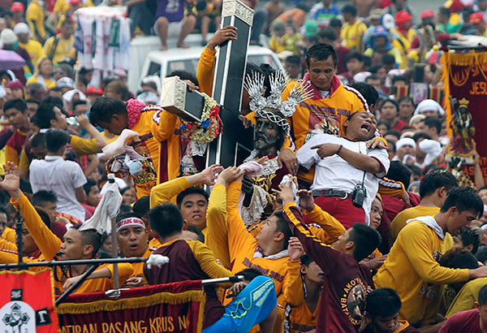
3. Courtship-serenading or harana in tagalog is one of the most popular form of courtship to show that a man is very serious with his intention to a woman. A serenade would require a young man that is accompanied by his male friend who act as back-up singer to sing a love song in front of young lady’s house.
4. Religion - one of the two predominantly roman catholic nations id asia-pacific. Filipinos believe that having a strong devotion may lead to a better life and their guidance to face everyday.

Slide 7
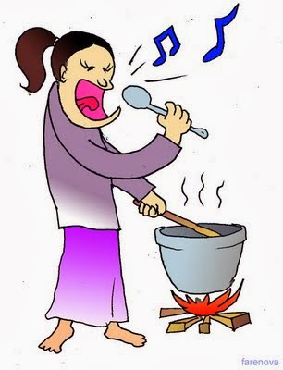
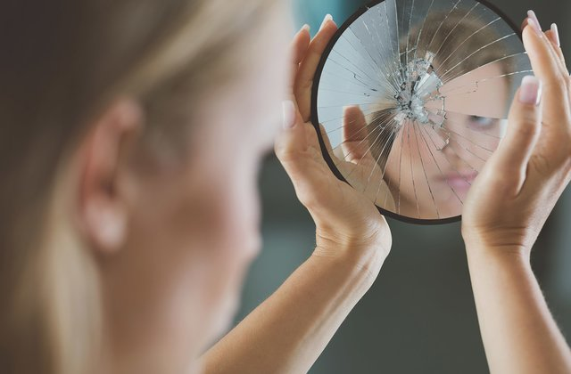
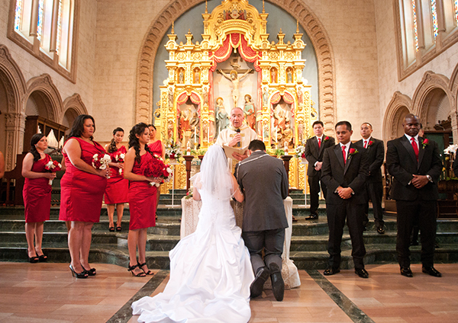
5. Superstitions- in the Philippines, superstitious belief have ground throughout the country. These beliefs comes from the different saying and belief of our ancestors that aim to prevent danger from happening or to make a person refrain from doing something on particular. Some are practiced primarily because Filipino believe that there is nothing to lose if they will comply with these beliefs.
6. Marriage and wedding customs- it is a sacrament between to people love each other. For many Filipinos, the eternal quality of dedication to God pervades a truly sacred marriage.

Slide 8
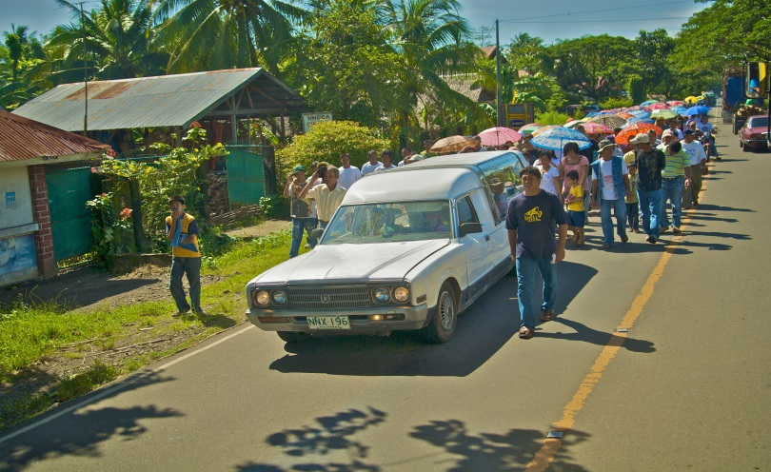
7. Death – most important occasions in family life. Opportunity to strengthen ties in the family. To pay respect to the deceased , long-lost relative, friend and even relatives working abroad reunited. Philippines is the home of some unique death rituals that are partly religious and mostly superstitious.
After the death of a person, nine-day period of having novena of prayers and masses are offered up to the deceased is held. Another period follows after death is 40-days mourning period. Family members indicate their state of bereavement by wearing a small black rectangular plastic pin on their left breast or breast pocket area. Common beliefs states that the soul goes to heaven after 40-days, following the belief that Jesus Christ ascended to heaven after the said period of days.

Slide 9
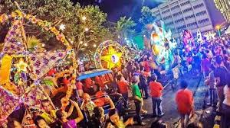
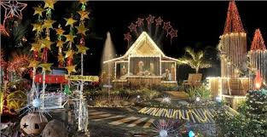
8. Society-the primary ancestors of the Filipinos are Malays who came from the South Eastern Asian country. Philippines is a combined society both singular( nation) and plural( fragmented geographically and culturally) form.
9. Christmas in the Philippines - biggest holidays in the archipelago. We earned longest Christmas season from September until epiphany, feast of black Nazarene, January 9 or the feast of Sto. Nino de Cebu on the third Sunday of January. For many Filipinos, the true essence of Christmas is not gift giving but sharing the special holiday with the family.

Slide 10
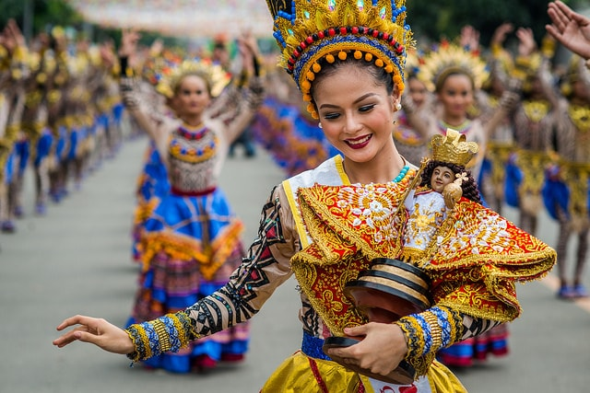
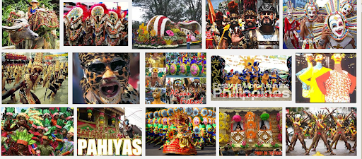
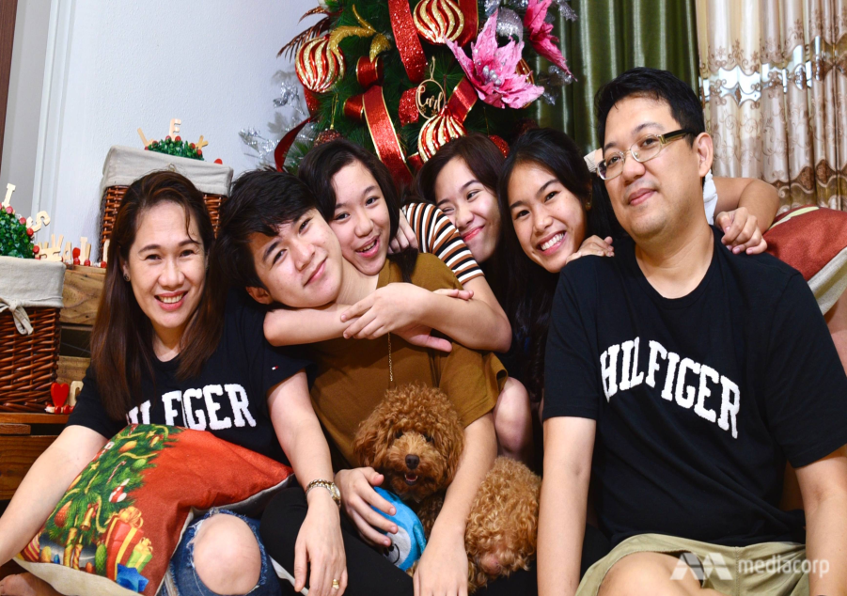
10. Fiestas- every town and city in the Philippines has fiesta it is use to celebrate the patron saint . the biggest and most elaborate festival is the Christmas . Fiesta is one way to celebrate their blessings, commemorate their past and observe solemn religious rituals. Spanish influence is evident in the elaborate masks, makeup, headdresses and costumes worn the revellers.
11. Living with parents- adult children living with their parents are another Filipino traditional which makes them exceptional.

Slide 11
Characteristics of Filipino Culture
Filipinos are very resilient.
-We always manage to rise above the challenge.
2. Filipinos take pride in their families.
-Family first
3. Filipinos are very religious.
-Religious paraphernalia can be found in all corners of a Filipino house.
-Goes to church every Sunday
4. Filipinos are very respectful.
- po and opo when addressing elders
-pagmamano
5. Filipinos help one another
- Bayanihan

Slide 12
6. Filipinos value traditions and culture
-Celebrations like festivals, birthday parties, reunions, etc.
7. Filipinos have the longest Christmas celebrations.
-As early as August until around the first or second week of January.
8. Filipinos love art and architecture.
-We love to design creatively.
9. Filipinos are hospitable.
-Usually during fiestas and holidays, Filipinos are giving their best to entertain their visitors.

Slide 13
Filipino Family Values
1. Paggalang (Respect)
-Filipinos are accustomed to using the words "po", "opo", and "ho"
-It can also be shown toward your elders by kissing their hands before leaving/to say goodbye and upon arrival/to greet them.
2. Pakikisama (Helping Others)
-Pakikisama has the connotation of getting along with people in general.
-This trait usually fosters general cooperation and performing good or helpful deeds, which can lead to others viewing you in a favorable light.

Slide 14
3. Utang na Loob (Debt of Gratitude)
-Utang na loob means to pay your debt with gratitude.
-With utang na loob, there is usually a system of obligation.
4. Pagpapahalaga sa Pamilya (Prioritizing Family)
-Pagpapahalaga sa pamilya is in other words, putting importance on your family. This implies that a person will place a high regard on his/her family and prioritize that before anything else.
5. Hiya (Shame)
-This controls the social behaviors and interactions of a Filipino.
-It is the value that drives a Filipino to be obedient and respectful to their parents, older siblings, and other authorities.

Slide 15
6. Damayan System
-Extending sympathy for people who lost their loved ones.
7. Compassionate
-A Filipino trait of being sympathetic to others even the person is a stranger.
8. Fun-loving Trait
-A trait found in most Filipinos, a trait that makes them unique that even in times of calamities and other challenges in life, they always have something to be happy about, a reason to celebrate.

Slide 16
Social Values of the Filipinos
1. High regard for amor propio (self-esteem)
- Self-esteem reflects an individual's overall subjective emotional evaluation of his or her own worth.
2. Smooth interpersonal relationships
- An interpersonal relationship nature of interaction that occurs between two or more people. People in interpersonal relationship may interact overtly, covertly, face-to-face. anonymously.

Slide 17
3. Personal alliance system
- A Filipino loyalty goes first to the immediate family, identity is deeply embedded in the web of kinship. It is normative that one owes support, loyalty, and trust to one's close kin.
4. The Compadre system
- Bonds of ritual kinship, sealed on any of three ceremonial occasions- baptism, confirmation, and marriage- intensify andextend personal alliances.
-This mutual kinship system, known as compadrazgo or compadre, meaning god parenthood or sponsorship, dates back at least to the introduction of Christianity and perhaps earlier.

Slide 18
Utang-na-loob
- A dyadic bond between two individuals may be formed based on the concept of utang na loob. Although it is expected that the debtor will attempt repayment, it is widely recognized that the debt can never be fully repaid and the obligation can last.
Suki relationship
- In the commercial context, suki relationships (market-exchange partnerships) may develop between two people who agree to become regular customer and supplier.
7. Friendship
-a willingness to help one another provides the prime rationale for the relationship.

Slide 19
Weaknesses of the Filipino Character
1. Passivity and lack of initiative
- Acceptance of what happens, without active response or resistance.
2. Colonial mentality
- Colonial mentality more strictly refers to the attitude the Filipinos feel that products coming from other countries are more superior than the local products.

Slide 20
3. Kanya-kanya syndrome
- Filipinos have a selfish, self-serving attitude that generates a feeling of envy and competitiveness towards others, particularly one's peers who seem to have gained some status or prestige.
4. Extreme personalism
-manifested in the tendency to give personal interpretations to actions.
5. Extreme family centeredness
-Excessive concern for family manifests itself in the use of one's office and power as a means of promoting the interest of the family, in factionalism, patronage, and political dynasties and in the protection of erring family members.
-It results in lack of concern for the common good and it acts as a block to national consciousness.

Slide 21
6. Lack of discipline
-Procrastination is one reason of lack of self-discipline.
-Lack of willpower, motivation and ambition are also causes for lack of self-discipline.
7. Lack of self-analysis and reflection
-In the face of serious problems, both personal and social, there is lack of analysis or reflection. We joke about the most serious matters and this prevents looking deeply into the problem. There is no felt need to validate our hypotheses or explanation of things. Thus, we are satisfied with superficial explanations and superficial solution to problems.
8. Ningas Cogon
– enthusiastic at first but ends in accomplishing nothing.
9. Gaya-Gaya Attitude
– imitating or copying other culture or style.

Slide 22
“All men make mistakes, but a good man yields when he knows his course is wrong, and repairs the evil. The only crime is pride.”
― Sophocles, Antigone

