Slide 1

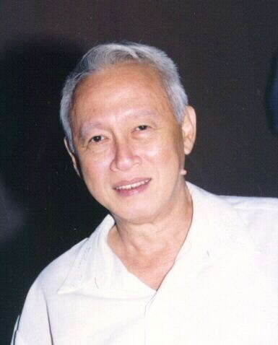
Francisco Arcellana
Francisco "Franz" Arcellana (September 6, 1916 – August 1, 2002) was a Filipino writer, poet, essayist, critic, journalist and teacher. He was born on September 6, 1916. Arcellana already had ambitions of becoming a writer early in his childhood.
Died
August 1, 2002 (aged 85) Quezon City, Philippines

Slide 2

Achievements
Carlos Palanca Memorial Awards for Short Story
Arcellana's published books include:
Selected Stories (1963)
Poetry and Politics: The State of Original Writing in English in the Philippines Today (1979)
The Francisco Arcellana Sampler (1991)
The Mats (1938)

Slide 3
What is the lesson of the story?
"The Mats" teach us that family is very important, even if they are gone they will still be alive in our hearts.
How the story affect to the Filipino?
In the Philippines most Filipinos are family oriented so it means that "family" has always be a special place in their hears, even if their gone the love that we offer to that family member will still be the same even after they are alive.
The appreciation in the Text and Writings
I really appreciate the text and writings of "The Mats" because even if you are reading the words of the story, you will feel the passion and love in every single words that is written. The reaction and comments to the Authors. I love how he's works really symbolize the filipino culture and how he writes his stories it is full of genuinity and authencity.

Slide 4
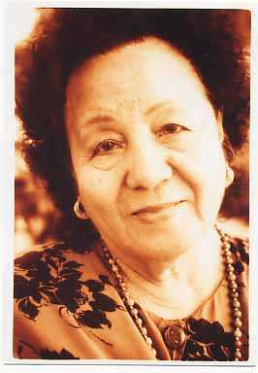
Edith Tiempo
Edith L. Tiempo, poet, fiction writer, teacher and literary critic was a Filipino writer in the English language. Tiempo was born in Bayombong, Nueva Vizcaya. Her poems are intricate verbal transfigurations of significant experiences as revealed, in two of her much anthologized pieces, "Halaman" and "Bonsai

Slide 5
Achievements and Awards:
Carlos Palanca Memorial Awards for Poetry Carlos Palanca Memorial Awards for Short Story
Lesson of the story:
"BONSAI" “Bonsai” by Edith Tiempo is basically a poem talking about love. ... In this part, the poet is telling its readers that love can only be for a moment or temporary because hatred could come which could destroy love and at the same time, love can also be forever or eternal.
Appreciation of the text:
whose works are characterized by a remarkable fusion of style and substance, of craftsmanship and insight.

Slide 6
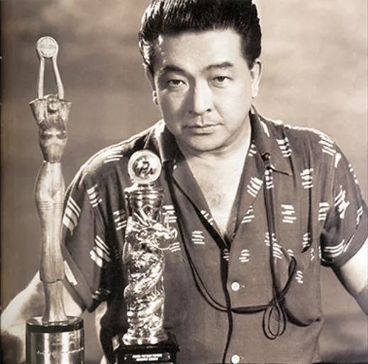
Lamberto Avellana
Lamberto Vera Avellana (February 12, 1915 – April 25, 1991) was a prominent Filipino film and stage director. Despite considerable budgetary limitations that hampered the post-war Filipino film industry, Avellana's films such as Anak Dalita and Badjao attained international acclaim. In 1976, Avellana was named by President Ferdinand Marcos as the very first National Artist of the Philippines for Film. While Avellana remains an important figure in Filipino cinema, his reputation as a film director has since been eclipsed by the next wave of Filipino film directors who emerged in the 1970s, such as Lino Brocka and Ishmael Bernal.

Slide 7
Fast Facts
Initially aimed to get established in the Filipino theater industry; played Joan of Arc at the age of 20.
Featured in many University of Philippines' plays; formed the Barangay Theater Guild along with his future wife.
Made his directorial debut with the film Sakay (1939), which won him great reviews from critics and journalists alike.
The success of his first movie earned him the title The Boy Wonder of Philippine Movies.
Won a Grand Prix Award at the Asian Film Festival for the movie Anak Dalita (1956).
Became the first Filipino filmmaker to have his film Kandelerong Pilak (1954) screened at the Cannes International Film Festival.
Is also the first-ever Filipino to be named National Artist for Theater and Film in 1976.
One of his classics A Portrait Of The Artist As Filipino (1965) is his first movie to be restored in 2015.
Has been immortalized with the release of three stamps carrying his portrait in February 2015, as a way of marking his birth centenary and celebrating the National Arts Month.

Slide 8
Achievements
Asia-Pacific Film Festival
1956 | Winner APFF Award | Best Film Anak dalita (1956)
Bilbao International Festival of Documentary and Short Films
1961 | Winner Conde de Foxa Award | La campana de Baler (1961)
 |  | La campana de Baler (1961)
1959 | Winner Conde de Foxa Award | El legado (1959)
 |  | El legado (1959)

Slide 9
Gawad Urian Awards
1981 | Winner Lifetime Achievement Award
Metro Manila Film Festival
1991 | Winner Posthumous Award

Slide 10
FAMAS Awards
1969 | Nominee FAMAS Award | Best Director Kumander Dimas (1968)
1966 | Nominee FAMAS Award | Best Director A Portrait of the Artist as Filipino (1965)
1965 | Winner FAMAS Award | Best Director Scout Rangers (1964)
1960 | Nominee FAMAS Award | Best Director Cry Freedom (1959)
1957 | Nominee FAMAS Award | Best Director Kumander 13 (1956)
 |  | Best Story Medalyong perlas (1956) For the segment "Welga".
 |  | Best Screenplay Medalyong perlas (1956) For the segment "Welga".
1954 | Winner FAMAS Award | Best Director Huk sa bagong pamumuhay (1953)

