Slide 1


Logging in to your Microsoft 365 account

Slide 2
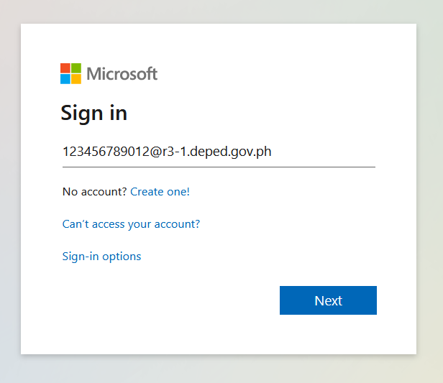
Go to office.com and log-in with your Deped Office 365 account.
Note: If you don't have your DepEd Office 365 account yet, consult your school ICT coordinator.

Slide 3
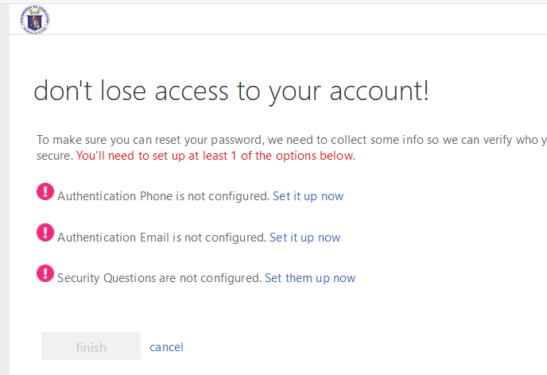
Set up any one of the following:
1. Mobile phone
2. Personal email
3. Security questions

Slide 4
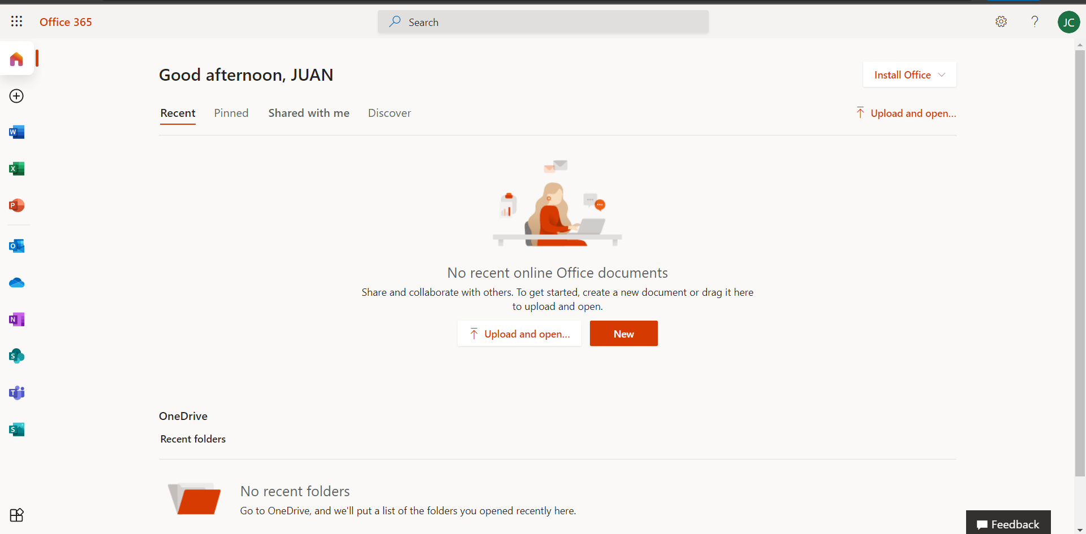
Download the latest and licensed Office applications in your own devices.
Access your Office 365 apps here.

Slide 5
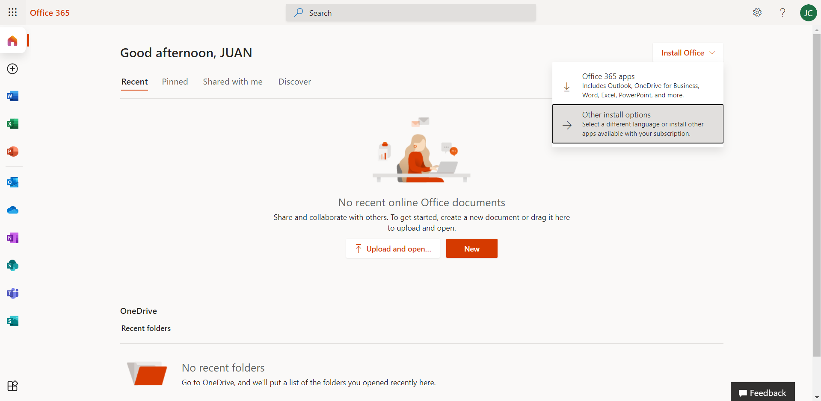
Installing Microsoft Office on your devices
Select Install Office and click Office 365 apps

Slide 6
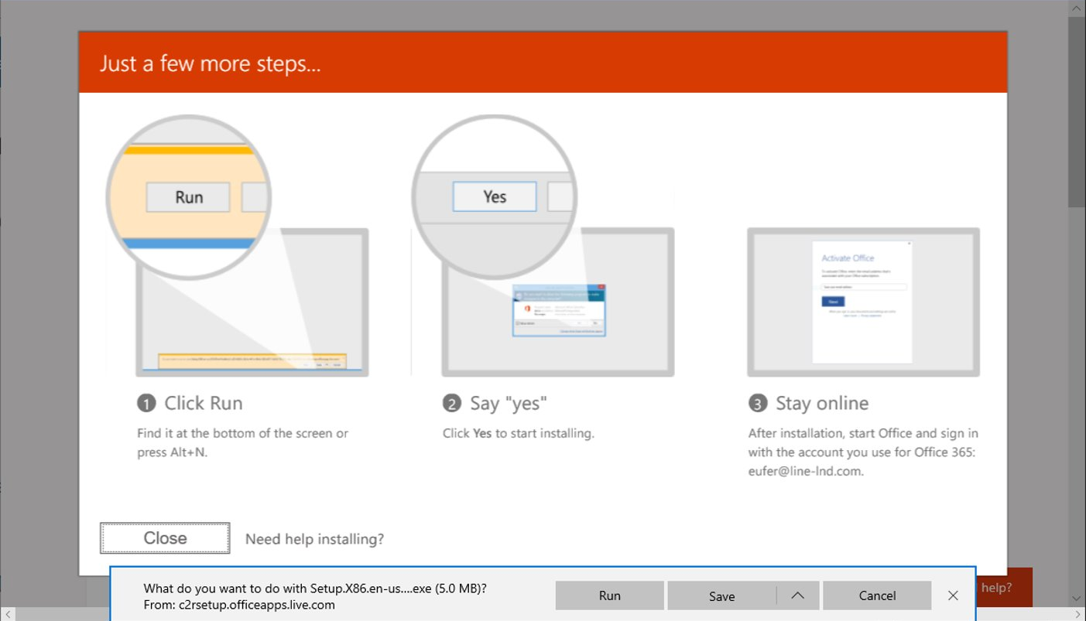
Click Run to start the installation process

Slide 7
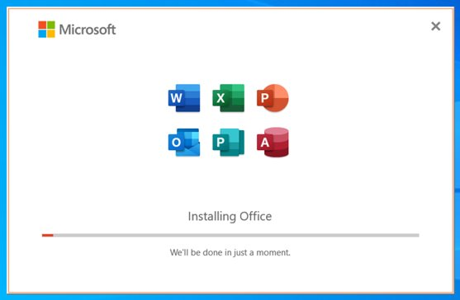
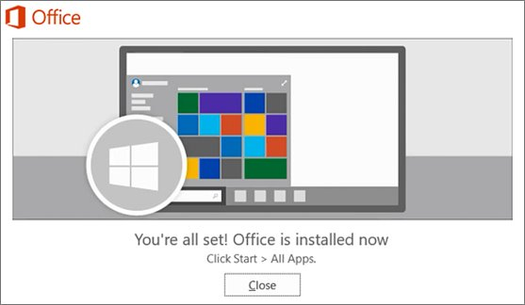
Sit back and relax while Office is being installed in your PC​
Stay connected to the internet during installation​
Installation time may vary depending on your connection speed.

Slide 8

Office 365 Password Reset and Management

Slide 9

Password Reset Process for DepEd Office 365 Accounts
If Self-service Password Reset (SSPR) is enabled in your account
    Proceed and click forget password button. Input the required information like phone number or alternate email to recover your account
    You will receive an SMS, email containing an authentication code or a set of security questions for you to answer.
    If a code is received from either text or email, input the code sent and change your password
    Be sure to secure your password and do not share it with anyone.

Slide 10
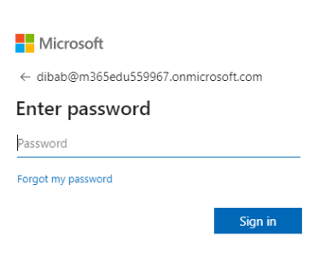
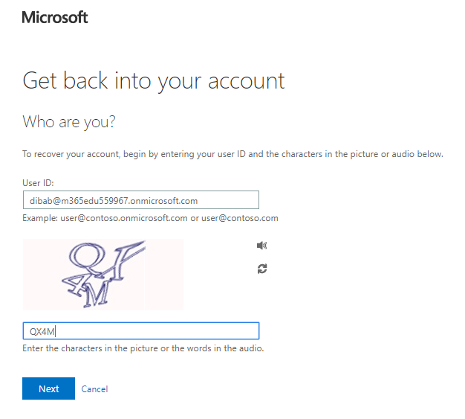
Step-by-step process for Self-service Password Reset (SSPR)
Login at Office.com and click Forgot my password
Input your user account and captcha then click Next
123456789012@r3-1.deped.gov.ph
1234567890123@r3-1.deped.gov.ph

Slide 11
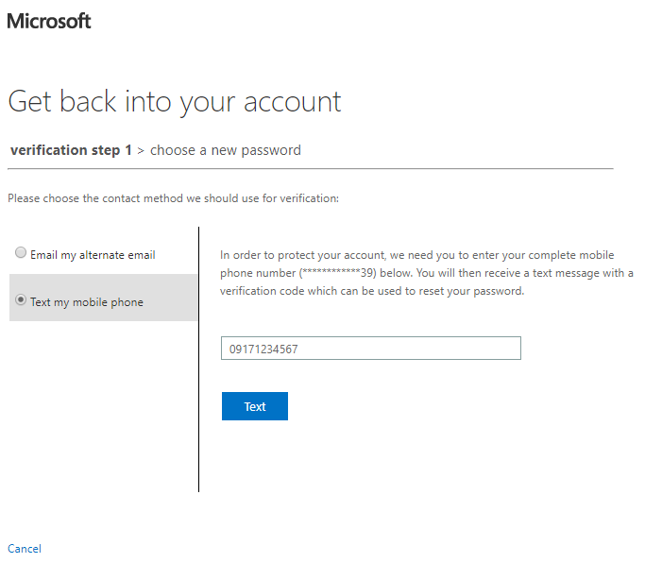
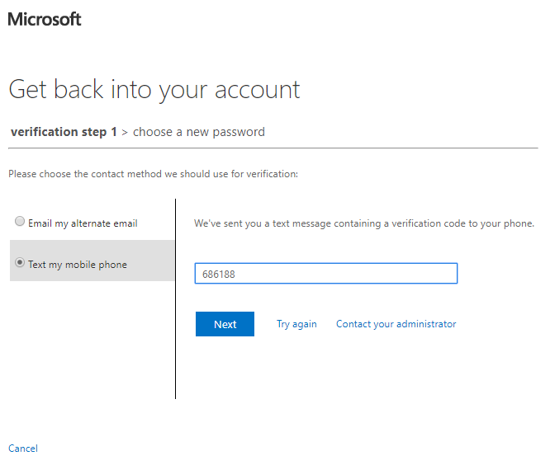
Step-by-step process for Self-service Password Reset (SSPR)
Chose an authentication method – mobile or email. For mobile phone, you need to input the mobile phone you used during your initial login in Office 365 then click Text
You’ll receive an SMS that contains the authentication code. Input the code in the field provided and click Next
09171234539

Slide 12
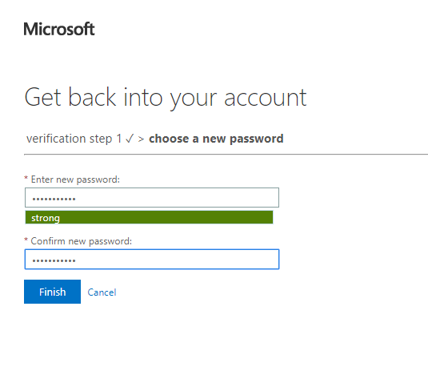

Step-by-step process for Self-service Password Reset (SSPR)
Enter your new password then click Finish
Go back to Office.com and login using your new password

