Slide 1
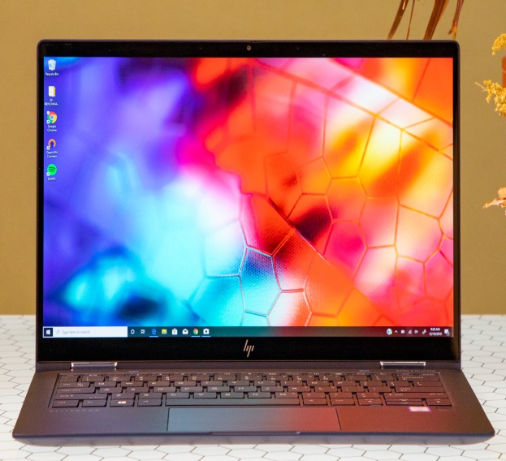
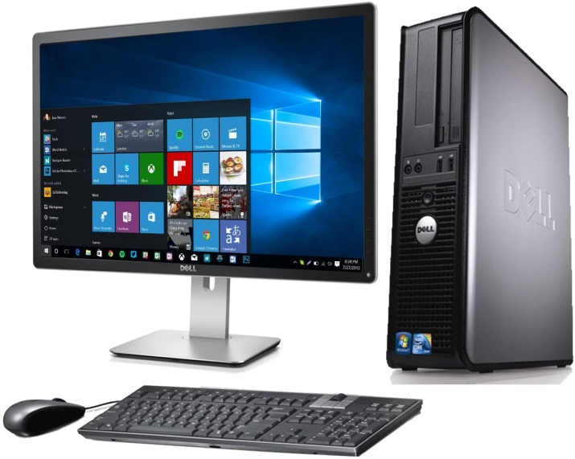
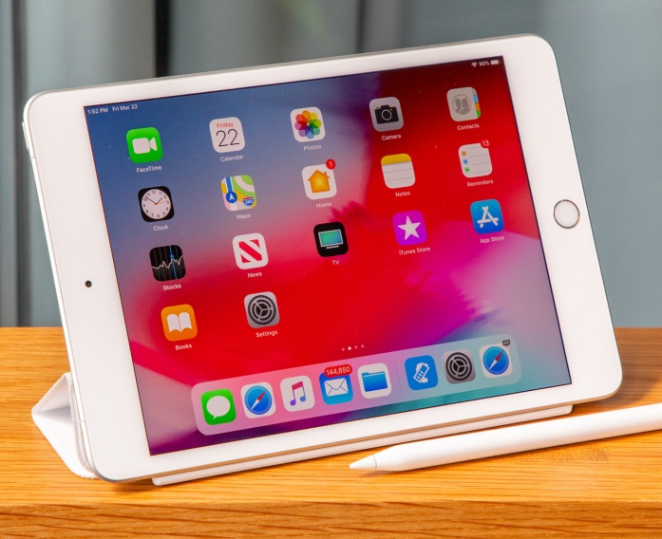
Hardware Requirement’s
Hardware : Laptop or Desktop or Ipad
OS : Windows & MacOS

Slide 2
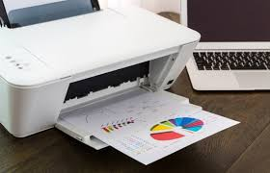
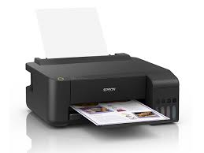
Printer Requirement’s
Hardware : Any Paper Printer

Slide 3
System & Hardware Requirement’s
System : Filemaker
Auto Back-up Software : Free File Sync
RAM : 2gb or higher
CPU : Pentium or higher
Hard disk : 1gb or higher
GPU : built-in / Onboard or GPU

Slide 4
Screen Resolution
Fit to
1366 x 768 dpi

Slide 5
Account’s
FREE |  |  |  |  | AVAIL 1,000 Php – Free Setup
username | password | secuity | Can Change Password |  | username | password | secuity | Can Change Password
encoder1 | blank | level 2 | ü |  |  | blank | level 2 | ü
manager | blank | level 3 | X |  | manager | blank | level 3 | ü
 |  |  |  |  | plus additional 3 accounts w/ custom username
 |  |  |  |  | 2 account for level1 - vice versa
 |  |  |  |  | 1 account for level2 - vice versa
note: wag mong e type ang password na "blank", Just leave it empty then enter. |  |  |  |  | Ex: username: Gusion

Slide 6
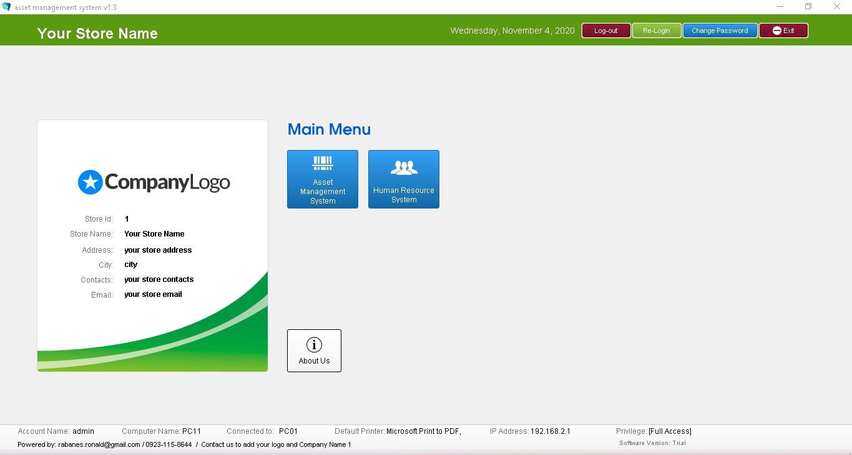
Introduction Main Menu

Slide 7
Introduction Main Menu
Company Information
Logout, Login, Change Password, Exit
Taskbar Status
  User Account
  Computer Name
  Default printer
  IP address
  Privilege

Slide 8
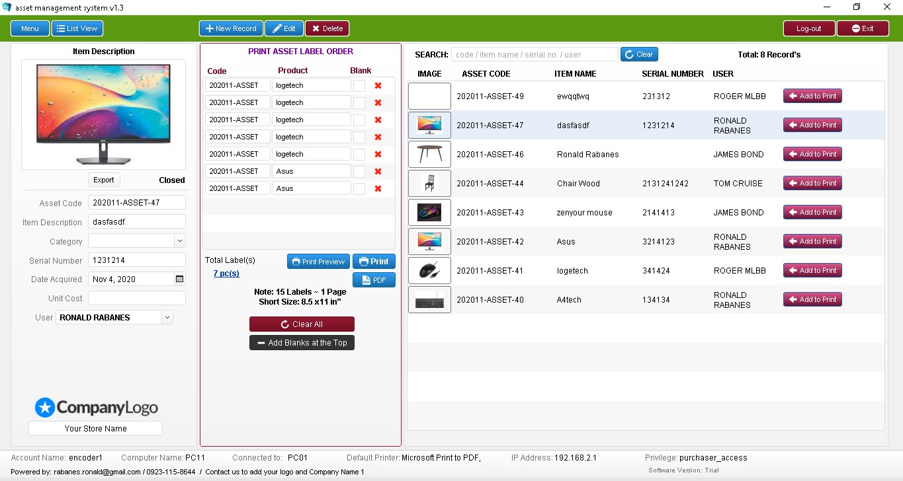
Asset Information

Slide 9
Asset Information
Do -
Menu
List View
New Record
Save Record
Edit Record
Print Record
Search
View All Records
Upload Picture
Delete Picture
Export Picture Autosave
Add to print order – Main
Clear all orders
Add blanks
Don’ts - Privilege: Level 3
Delete

Slide 10
Asset Information
Do -
Add New User

Slide 11
Customer Information - Triggers
Item Description- blank
User - blank

Slide 12
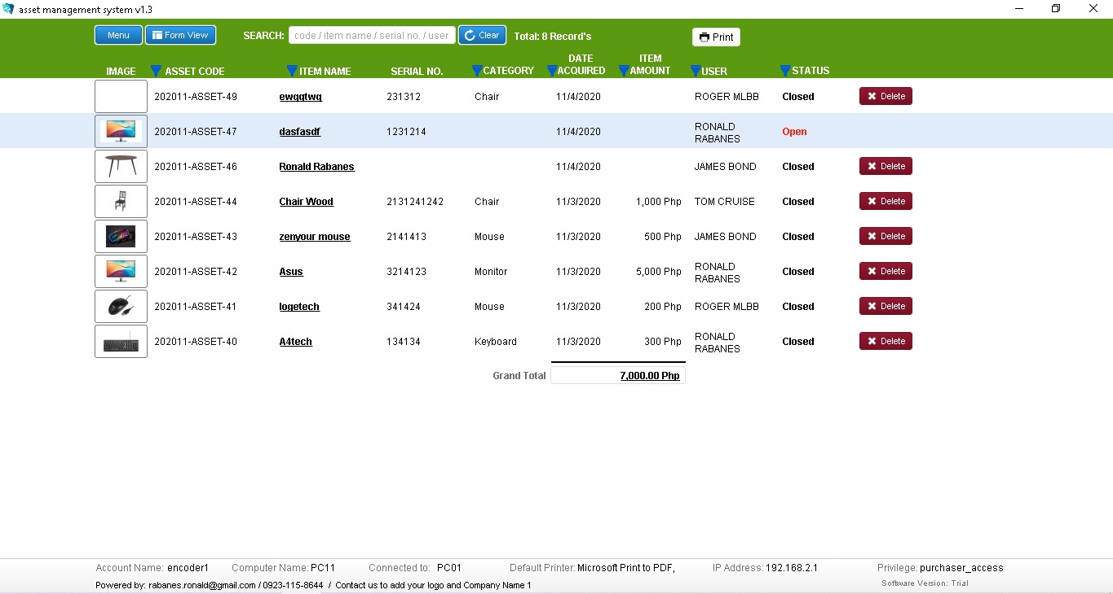
Asset List View

Slide 13
Asset List View
Do - Privilege: Level 1
Don’ts Privilege: Level 3
Search Information
Print List View
No result found
Sort Record’s
  Asset code, category, user, etc.
Delete

Slide 14
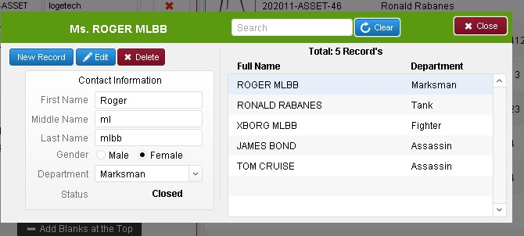
User Information

Slide 15
User Information
Do’ - Privilege: Level 2
Don’ts - Privilege: Level 3
New Record
Save Record
Edit Record
Search
View All Records
Delete Record.

Slide 16
User Information - Triggers
First name - blank
Last name - blank
Gender - blank

Slide 17


Free File Sync Tutorial
Automatic
Backup Files

Slide 18
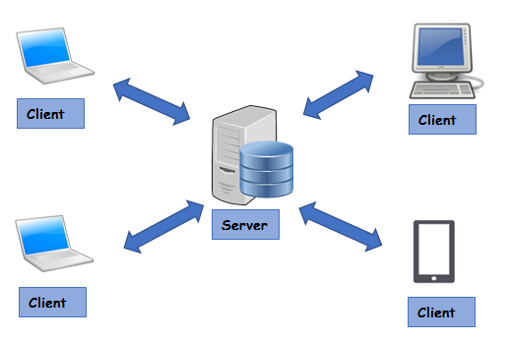
LAN & Wireless Network Works
Part 2 - Tutorial

Slide 19
Bugs and error
Email us: rabanes.ronald@gmail.com
Or text: 09231158644

Slide 20
End
Salamat sa panood
Subscribe naman jan ^_^
Pa like nadin and share
Masaya din kung may comment kayu or suggestion, comment nyu lang sa baba

